Slide 1
FAILURE IN REAL BONDED STRUCTURES
Adhesive Bond Failure Forensics
Dr. Maxwell Davis PSM, B.Eng (Mech.), M. Eng (Mech.), PhD (Honorary) RPEQ
Director, Adhesion Associates Pty. Ltd.
Andrew McGregor B.Eng (Mech) CPEng, ATPL
Director, Prosolve NZ Ltd.
©Adhesion Associates Mar 2016 Revision 1.0

Slide 2
Introduction
Structural integrity of adhesive bonds:
  Design and certification demonstrate ultimate load capability
  NDI and damage tolerance analysis (DTA) demonstrate limit load capability in the presence of a nominal defect
FEA and testing are based on artificial defects to demonstrate sustainment of limit load without failure
This approach will NOT prevent all bond failures
A probable in-flight bond failure resulting in a fatal crash brings this methodology into question
  Structure had passed several NDI and visual inspection within 80 hrs of crash
©Adhesion Associates Mar 2016 Revision 1.0

Slide 3
Introduction
This presentation will explain:
  How stresses are distributed in adhesive bonds
  How adhesive bonds function
  How and why adhesive bonds fail
  Effects of failure modes on the load at which the bond fails
  The conditions where NDI and DTA may not be appropriate for management of structural integrity of principal structural elements
©Adhesion Associates Mar 2016 Revision 1.0

Slide 4
What to do when a bond fails?
If bond failure occurs do you:
  Run an FEA model to check the bond stresses
  Check the certification basis test results for anomalies
  Change the adhesive to a stronger one
  Look for better strength tests to validate the adhesive selection
  Blame the QA guys for not preventing the failure
  Undertake NDI on the remaining fleet
  Blame the operator:- the bond was fine when it left the factory
  Look at the history of the aircraft to identify an event to pin the blame on (e.g. tail strike caused “undetected” damage)
Undertake failure forensics to identify the type of failure and the probable cause: Initiate corrective action
©Adhesion Associates Mar 2016 Revision 1.0

Slide 5
What determines bond strength?
The strength of a bond depends on two factors:
  Strength of bulk adhesive
  Strength of the interface(s) between the adhesive and adherends
Bulk adhesive strength is mainly a materials selection and design issue with limited process and environmental input
Interfacial performance totally depends on production processes
Design cannot address interfacial weakness: strength decays with time
©Adhesion Associates Mar 2016 Revision 1.0

Slide 6
Issues to be discussed
The following slides address:
  Managing failure of the bulk adhesive by design and testing
  Understanding and preventing interfacial failure
©Adhesion Associates Mar 2016 Revision 1.0

Slide 7
Bulk adhesive failure: joint design
Many designs use average shear stress
  Assumes shear stress is uniform
  Double overlap → double load
Reality: Stresses are NOT uniform
  Peak stresses at ends
  Increasing overlap only adds to zero stress zone
Using average shear stress to measure bond strength is meaningless
The basic thrust of AC 20-107B is based on average shear stress design
Extensive testing and knock-down factors essential to support design
There is a better way!
Actual Stress (elastic)
Average Stress
Shear Stress
©Adhesion Associates Mar 2016 Revision 1.0

Slide 8
Elastic-plastic stress distribution
When stresses exceed adhesive elastic limit, plastic zones form at ends of joint
If overlap is adequate, elastic trough remains
Joint fails when max shear strain is exceeded at end or when the adherend itself breaks
Loaded above adhesive elastic limit
Shear
Stress
Loaded below adhesive
elastic limit
Failure at γ_{max}
Failure at γ_{max}
Failure at F_{ULT}
©Adhesion Associates Mar 2016 Revision 1.0
Notes:
If a joint is loaded such that the shear stresses in the adhesive exceed the elastic limit, plastic zones form at the ends of the joint. Because the adhesive is assumed to be ideally elastic-perfectly plastic these plastic zones will be assumed to be of a uniform stress (the value will be τ_{p}). Provided the overlap length is sufficient, the shear stress trough will still be zero at the middle of the joint and an elastic trough will still exist.
Failure of the joint will occur when the strain at one end of the joint exceeds the maximum shear strain (γ_{max}).
Hart-Smith, L.J. Adhesive Bonded Single Lap Joints, NASA CR 112236, Jan 1973

Slide 9
Adhesive design properties
Adhesive properties: Thick Adherend Test ASTM D5656
Shear stress vs shear strain
  Not just average shear stress
Test over entire service temperature range
Up to 80% of strain energy to failure from plastic behavior
τ_{p}
Model
Shear Stress
True curve
Equal areas
G
γ_{e}
γ_{max}
Shear Strain
©Adhesion Associates Mar 2016 Revision 1.0
Notes:
Hart-Smith, L.J. Adhesive Bonded Single Lap Joints, NASA CR 112236, Jan 1973

Slide 10
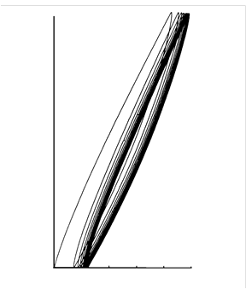
Plastic behaviour in adhesive bonds
Despite the adhesive exceeding the elastic limit, damage may not be cumulative for moderate loads
  Only occurs in badly designed joints between stiff, thick adherends, or joints with short overlap lengths
For well designed joints the elastic trough provides recovery of plastic deformation
The overlap length must be sufficient to provide the elastic trough
LOAD
OPENING DISPLACEMENT
©Adhesion Associates Mar 2016 Revision 1.0

Slide 11
Load capacity
The real measure of the strength of a bond is not the average stress at failure – it is the load the bond can carry: The Load Capacity
Load capacity is the load a bond can sustain in the absence of adherend failure (Hart-Smith)
  Can be calculated
  Equations take into account service temperature, adhesive properties, stiffness of adherends, thermal stresses
If the load capacity of the bond exceeds the load that can be carried by the surrounding structure, the adhesive will never fail
  Provided the failure mode is by shear
To save time the equations have been omitted but I can supply them on request
©Adhesion Associates Mar 2016 Revision 1.0

Slide 12
Bond load capacity
Strength of adhesive depends on SQRT of adherend thickness
Strength of adherends is linear
Left of cross-over, adherend is weaker than adhesive
  Adhesive will never fail
Right of cross-over adhesive is critical before structure undesirable
  Extensive testing required
True for shear failure mode
Overlap MUST be adequate
Processing must be valid
Adherend at DUL
Shear
Strength
Bond stronger
Bond weaker
A
B
Adherend Thickness
©Adhesion Associates Mar 2016 Revision 1.0
Notes:
Analysis may be used to calculate the potential strength of an adhesive bond. As will be seen later, the strength of a bond depends upon the square root of the thickness of the adherends. The strength of the adherends is a linear relationship with thickness (if the thickness is increased, the strength increases proportionately). If these two curves are plotted together the strength of the adhesive will be higher than the strength of the adherends for thinner adherends, while the opposite is true for thicker adherends. Hence, for any adherend thickness to the left of the cross-over point, the adhesive will be stronger than the adherend. For any point to the right of the cross-over, the adhesive will be the critical element in the joint.
A similar plot can be made by replacing DUL with the un-notched material ultimate strength of the adherend. In such a case, to the left of the cross-over there will be no load case which will result in failure of the bond because the adherend will always fail at F_{ult}.
This is a very powerful concept because for adherends thinner than the cross-over (about 0.15 inches for typical aluminium alloys) it is possible to design joints in which the adhesive will never fail.
Naturally, this condition depends on the joint having an adequate overlap length such that the shear stress trough still decays to zero. It also depends totally on the validity of the processes used to bond the materials together.
Hart-Smith, L.J., Effects of Flaws and Porosity on Strength of Adhesive-Bonded Joints, 29th Annual SAMPE Symp. and Tech. Conf., Reno NV, 3-5 Apr 1984.

Slide 13
Overlap length and joint load capacity
Short overlap:- fully plastic
  Load capacity increases linearly
Once partial shear stress trough is achieved, additional overlap length has diminishing effect on load capacity
Once shear stress trough is fully developed additional overlap doesn’t change load capacity
Disbonds reduce the effective overlap
  If zero shear trough is lost, strength decays rapidly
Load
Capacity
Overlap
©Adhesion Associates Mar 2016 Revision 1.0

Slide 14
Peel stresses
Adhesives are highly susceptible to through-thickness tensile stress (peel)
Composites also susceptible to first ply delamination
Avoid wherever possible by designing load transfer by shear, not tension
©Adhesion Associates Mar 2016 Revision 1.0
Notes:
Adhesives work best by transferring load by shear, but they are highly susceptible to tensile stresses which act to peel the joint apart. Similarly, tensile stresses may peel the first ply off composite structures or doublers. Peel stresses may be mitigated by design considerations such as tapering of the adherends at each end of the joint. The taper reduces the eccentricity and gradually introduces the change in load path.

Slide 15
Load path eccentricity
Bonded joints susceptible to peel stresses due to load path eccentricity
Joint bends to align neutral axes
May cause high peel stresses, yielding of adherends or delamination of composites
Exacerbated by short overlaps
©Adhesion Associates Mar 2016 Revision 1.0
Notes:
In a single overlap joint or bonded repair, the misalignment of the load paths results in a bending moment at the ends of the joint. This causes the joint to bend to reduce the load path eccentricity. This may result in significant peel (tensile) stresses through the adhesive, yielding of the adherends or delamination of composites. The problem is considerably worse if short overlaps are used.

Slide 16
Out-of-plane bending
Long overlaps: bending is not uniform along length
  Plane sections do not remain plane
For long overlaps, bending occurs near ends, no bending in middle
  Significant for crack repairs because bending is lower at crack than at ends
©Adhesion Associates Mar 2016 Revision 1.0
Notes:
For long overlaps, the bending occurs within a short distance of the ends of the joint, because plane sections do not remain plane as would be expected for simplistic beam-bending analyses. Away from the ends, the neutral axis of the total section dominates and there is no bending. This is particularly significant for repairs to cracks and other defects because bending at the defect is confined to a small distance (typically about one thickness of the adherend) from the defect.
Reference: Hart-Smith, L.J., Nonlinear Closed-Form Analyses of Stresses and Deflections in Bonded One-sided Splices and Patches, 3rd Joint FAA/DoD/NASA Conference on Aging Aircraft, Albuquerque, New Mexico, Sep 20-23 1999.

Slide 17
Effects of tapering ends
Tapered ends of joint are more compliant
  Higher strains in adherend reduce the displacement difference between the adherends
Results in lower shear strains at end
Tapering also reduces load path eccentricity at end
  Reduces peel stress in adhesive and adherends
Joint is more compliant
©Adhesion Associates Mar 2016 Revision 1.0
Notes:
Tapering also makes the end of the adherends more compliant, and therefore reduces shear stresses at the critical location in the joint. The thinner section creates higher strains in the adherend and thus lower shear stresses. The thinner section also minimises load path eccentricity thus reducing peel stresses.
Note that the joint is not tapered to a knife-edge because that would result in fatigue of the adherend tip.

Slide 18
Design allowable peel values
There is NO test which measures a peel stress allowable
  Tensile tests do not represent constraint of Poisson’s effect
All tests (T-peel, blister, climbing drum) are only comparative tests
  Do not result in a “design allowable” peel stress
Hart-Smith rule of thumb:
  10,000 psi for ductile adhesives
  6,000 psi for brittle adhesives and composite resins
©Adhesion Associates Mar 2016 Revision 1.0
Notes:
There is no test which actually produces design values for adhesive peel strength. In a bonded joint under tensile (peel) loads, the contractions normally associated with tension loading are actually constrained because they in turn produce shear stresses. Tensile tests of bulk adhesive are not constrained against Poisson’s effect.
Peel tests such as those specified by MMM 132-A (T-peel, blister detection and rolling drum tests) do not provide data which is useable for peel stress assessment. They only provide comparative values which can be compared between adhesives.
Hart-Smith provided a rule of thumb guide, whereby a value of 6000 psi is used for brittle adhesive systems and 10000 psi is used for ductile adhesives.
Hart-Smith, L.J., Design to Minimise Peel Stresses in Adhesive-Bonded Joints, Delamination and Disbonding of Materials, ASTM STP 876, 1985.

Slide 19
Environmental effects
Service temperature has a significant effect on bulk adhesive properties
  Low temperature: High shear modulus, high shear strength but minimal plastic strain capability
  High temperature: Lower shear modulus, lower shear strength but significantly more plastic strain capability
Design or testing must address the variation in properties
High temperatures and loads may cause creep especially near the Glass Transition Temperature
©Adhesion Associates Mar 2016 Revision 1.0

Slide 20
Service temperature
Adhesive properties depend strongly on temperature
Must address maximum and minimum service temperatures
  Properties change
Average shear stress approach uses knock-down factors to account for temperature effects on adhesive properties
-65ºF
75ºF
140ºF
Shear Stress
180ºF
220ºF
Shear Strain
Thick adherend data
ASTM D5656
©Adhesion Associates Mar 2016 Revision 1.0
Notes:
It is important to note that adhesive properties are strongly dependent on the operating temperature. At low temperatures, the shear strength is high, but the adhesive plastic behavior is comparatively small. As the temperature increases, the adhesive strength declines, but the plastic proportion of the stress-strain curve increases. Eventually, the adhesive is virtually linear elastic to failure at a temperature which approaches the glass transition temperature (the temperature at which the adhesive changes from a hard, glassy material to a soft compliant material). Above the glass transition temperature (T_{g}) the strength and the area under the stress strain curve are very low.
From this data, it may be seen that temperature is a significant factor in bonded joint behavior.
Again, the average shear stress design method relies on knock-down factors to account for the behavior of the adhesive at different temperatures.

Slide 21
Environmental effects: moisture
Environmental moisture effects both the bulk adhesive and the interface
Bulk adhesive effects addressed by short-term “moisture conditioned” specimen tests
Interfacial effects are TIME dependent
Short-term moisture conditioning will NOT address one of the most common failure modes caused by service moisture effects
©Adhesion Associates Mar 2016 Revision 1.0

Slide 22
INTERFACE: bonding mechanisms
Adhesive bonds rely on chemical bonds at the interface
  Determined by the surface preparation process when bonded
  Easy to generate short-term strength with simple treatments
Long-term strength depends on the durability of those interfacial chemical bonds
  Interfacial degradation over time may cause adhesion, mixed-mode failure ➔ lower strength
  Due to hydration of surface oxides over time (metals) e.g.
  Chemical bonds to adhesive dissociate, causing interfacial disbonding
Similar interfacial degradation may occur for non-metals
©Adhesion Associates Mar 2016 Revision 1.0

Slide 23
Strength variation along degrading interface
Strong
Hydration depends on moisture content in bond
  Moisture diffusion follows Fick’s law
The local strength of the interface will change along the bond
As moisture diffuses and hydration occurs disbonding spreads
Degrading interface
Weak
Local strength
Disbond
©Adhesion Associates Mar 2016 Revision 1.0

Slide 24
How to measure degrading joint strength
If the local strength varies along the joint and changes as hydration occurs then how is joint strength measured?
The true measure of joint strength is the LOAD at failure, not the average adhesive stress
The load at which the joint fails is the integral of the local strength of the bond over the length of the joint;- the load capability (my terminology)
Load capability of a degraded joint will determine the airworthiness - can the degraded joint sustain limit load?
  Average shear stress at failure is meaningless
  The shear stress predicted by FEA is meaningless
©Adhesion Associates Mar 2016 Revision 1.0

Slide 25
Adhesive bond failure types
Four types of bond failure:
  Cohesion failure
    Adhesive layer is fractured
  Adhesion failure
    Separates from the surface of the adherend(s)
  Mixed-mode failure
    Variable combination of adhesion and cohesion failure
  Peel failure
    Cleavage of the joint by out-of-plane forces
COHESION FAILURE
ADHESION FAILURE
MIXED-MODE FAILURE
PEEL FAILURE
©Adhesion Associates Mar 2016 Revision 1.0

Slide 26
Special failure mode for laminates
Laminated composites may exhibit a unique failure mode
Inter-laminar failure may peel the first ply off the laminate
  Peel stresses
  Shear stresses may exceed ILS
Not discussed further
INTER-LAMINAR FAILURE
©Adhesion Associates Mar 2016 Revision 1.0

Slide 27
Load capability and failure modes
Joint load capability correlates with failure mode
  Cohesion failure: full strength
    Fails through carrier cloth
  Adhesion failure: low strength
    Failure through interface
  Mixed mode: Intermediate, degrading with time since manufacture
    Failure transitions from carrier cloth towards interface
Cohesion
Load capability
Mixed-mode
Adhesion
Time since manufacture
Contamination
Degradation
©Adhesion Associates Mar 2016 Revision 1.0

Slide 28
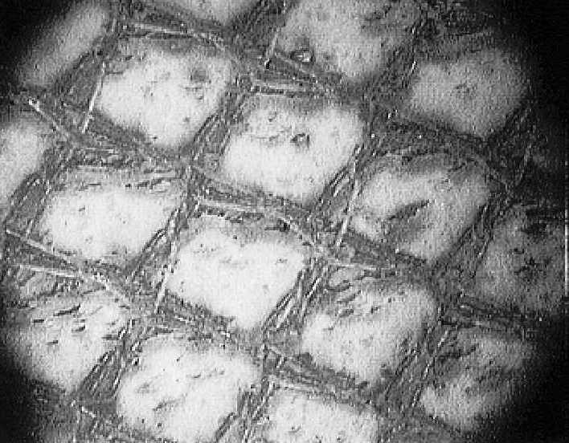
Cohesion failure
Occurs through carrier cloth
Strength is high
NDI can find large defects
DTA is appropriate
Cohesion
failure
Effective
bond
Required strength
Strength
NDI effective
DTA effective
Time
©Adhesion Associates Mar 2016 Revision 1.0

Slide 29
Cohesion failure: causes
Design causes Methods:
    Thermal stresses Analysis and testing
    Large stiffness mismatch Analysis and testing
    Inadequate bond overlap Analysis and testing
    Inadequate temp. range for adhesive Material selection and testing
    Peel stresses Analysis and testing
    Fatigue??? Design, analysis and testing
Production causes (see next slides):
    Macro-voids and porosity
Operator induced failure:
  Overload
    Should not occur for joints designed using the Load Capacity approach
©Adhesion Associates Mar 2016 Revision 1.0

Slide 30
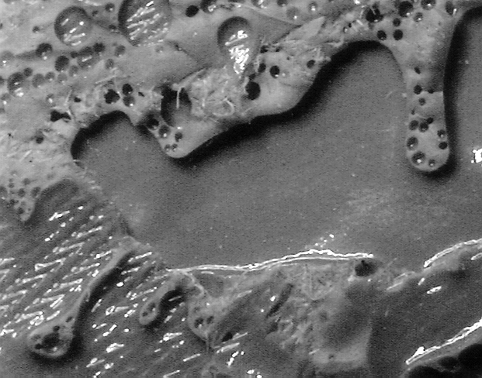
Cohesion failure due to macro-voids
Cohesion failure
Large voids in bondline
Found by post-production NDI
Does NOT occur due to service
Inadequate residual bond overlap – adhesive fractures
Surrounding adhesive is strong
NDI, DTA appropriate
Often “repaired” by injection
  Ineffective waste of time
  ONLY for defects smaller than the tolerable defect size
  Positive outcomes:
    NDI can’t find the defect
    Technician gets warm fuzzy feeling
Macro-voiding
©Adhesion Associates Mar 2016 Revision 1.0

Slide 31
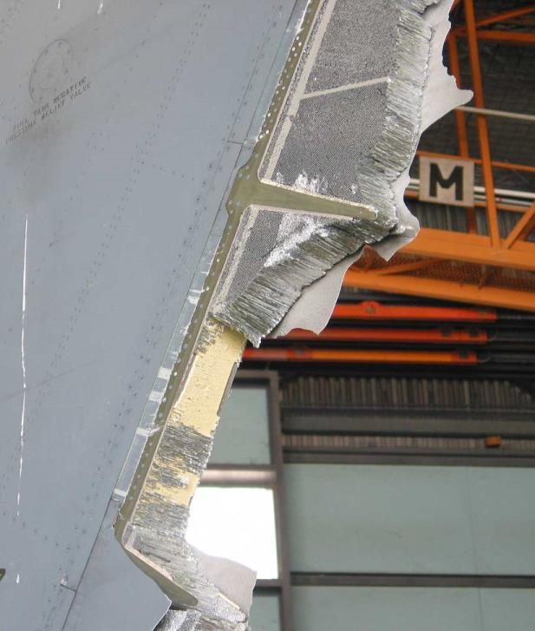
Case study: rudder production defect
Large area of disbond between core and mast had been injected
Fatigue cracking in skin adjacent to spar due to shear loads being transmitted through the skin, not adhesive
Rudder failed during high load event
If the disbond exceeds tolerable defect size, justify the repair by testing…
you may be disappointed
©Adhesion Associates Mar 2016 Revision 1.0
Notes:
This case study of an in-flight F-111 rudder failure demonstrates the danger of injection repair of large voids. In this case, there had been a very large injection repair to correct a massive void between the adhesive and the spar (mast) of the rudder in the area between the core and the foaming adhesive used to bond the core to the spar.

Slide 32
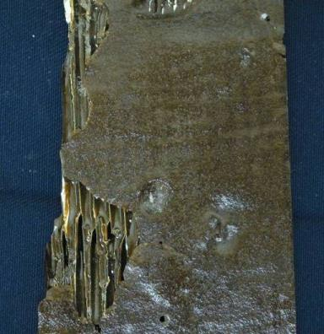
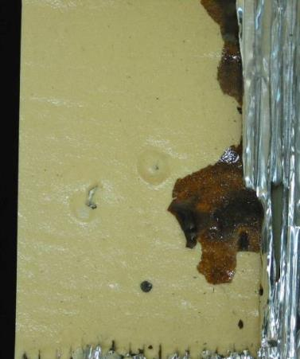
Rudder production defect
Closer examination detected very large injection repair to bond between core and mast
Injection easily separated from original adhesive
Injection repairs should be banned
©Adhesion Associates Mar 2016 Revision 1.0
Notes:
These photographs show the failure surface of the adhesive and the injected material. The failure is totally interfacial, indicating that there was never any effective bond between the void and the injected adhesive. The material was easily separated from the core adhesive by simple finger pressure. Note the accurate replication of surface features such as the injection holes.

Slide 33
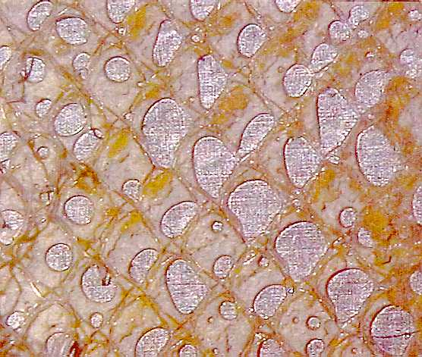
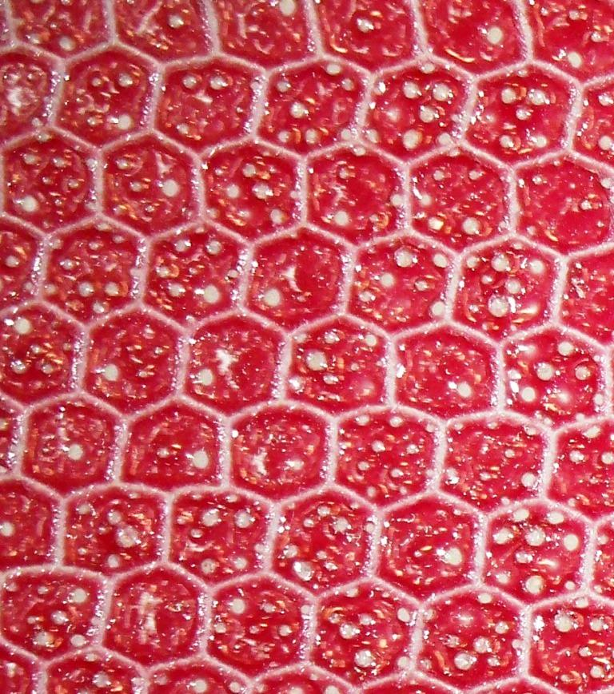
Cohesion failure due to porosity
Evolution of absorbed moisture during production cure cycle
Multiple small voids
Sufficient contact to pass NDI
Total defect size may exceed DTA
  Bond is weak
FM300 adhesive exposed to 30°C and 70% RH for 4 hrs
  53% loss of T-peel strength (ASTM 1876)
  28% loss of honeycomb peel strength (ASTM D1781)
Porosity does not occur in service
  May cause disbonds from fatigue, impact, high loads in service
Bonded
Joint
Sandwich
Panel
©Adhesion Associates Mar 2016 Revision 1.0

Slide 34
Porosity: NDI and DTA
Damage tolerance based on artificial defects CAN NOT represent multiple small voids
  There is no easy correlation between the artificial defect and the total overlap length lost due to porosity
  The test data shows that the remaining adhesive surrounding the porosity is much weaker than the pristine bond
This is one of the conditions where NDI and DTA can not prevent failure of bonded structures
Managed by controlling exposure of adhesives to humid environments prior to cure during production or repair
  During transport, receipt, handling and use
  Details are available in reference in paper
These procedures significantly reduce porosity
©Adhesion Associates Mar 2016 Revision 1.0
Notes:
Davis, M.J. , Managing Micro-Voiding of Adhesive Bonds, http://www.adhesionassociates.com/papers/Managing%20Micro-Voiding%20of%20Adhesive%20Bonds.pdf

Slide 35
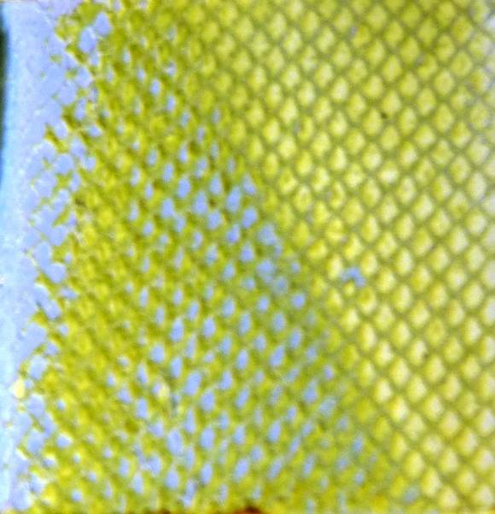
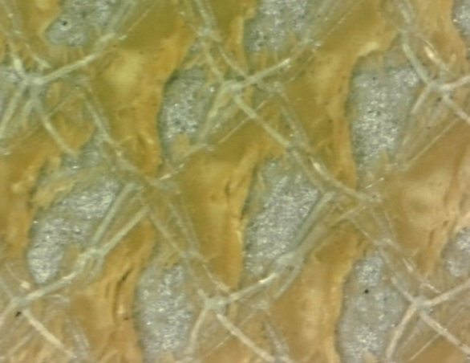
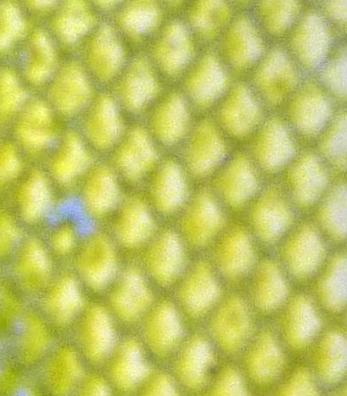
Cohesion failure due to peel
Some bond failures exhibit apparent adhesion/mixed mode failure which may be peel related
Cohesion peel failure is characterised by the presence of deep hackles
  Adhesive torn off surface in discrete regions which repeat
  Size of hackles depends on carrier cloth pitch
True adhesion failure would involve wide areas, not discrete sections
A design issue managed by tapering ends of joint, analysis and testing
Peel
Shear
©Adhesion Associates Mar 2016 Revision 1.0

Slide 36
Cohesion: Failure due to fatigue
There is a common perception that flight loads, flutter etc. cause fatigue failure of adhesive bonds –
Cohesion fatigue failures in adhesive bonds are rare and indicate bad design
Adhesion or mixed-mode fatigue failures result from interfacial degradation- loads are a secondary issue
In well designed joints, fatigue failure should not occur
True fatigue should result in failure through the carrier cloth or bulk adhesive
Interfacial fatigue failure will only occur if the interface is already degraded
©Adhesion Associates Mar 2016 Revision 1.0

Slide 37
Fatigue of structural bonded joints
PABST test program
  3-bay wide body fuselage specimens, GAG cycles
  100 mechanically fastened
  100 bonded
In 75,000 GAG cycles
  93 mechanical joints failed
  10 bonded joints failed---all from tooling holes
  NO BONDS FAILED
25
Fastened
20
Bonded
15
No. of Failures
10
5
0
2
14
21
29
34
42
49
59
65
75
Thousands of Pressure Cycles
©Adhesion Associates Mar 2016 Revision 1.0
Notes:
The superior fatigue performance of adhesives has been known for a considerable time. In the early 1980’s a test program evaluated the use of adhesive bonds for wide-bodied aircraft. Two hundred three-bay fuselage specimens were fabricated, half using conventional fasteners, the other half using adhesive bonding. The specimens were subjected to pressure cycles to simulate the ground-air-ground pressure cycle experienced by pressurised fuselages. During 75000 cycles, 93 of the mechanically fastened structures failed due to fatigue at the fasteners. In the same period, only ten of the bonded structures failed from fatigue cracks which developed at a tooling hole, away from the bond. None of the adhesive bonds failed in fatigue.
Fatigue failure of adhesive bonds is exceptionally rare and are usually associated with an inadequate overlap length which results in damage accumulation.
Hart-Smith, L.J., Structural Details of Adhesive-Bonded Joints for Pressurized Aircraft Fuselages, Douglas Report MDC J8858, Dec 1980.

Slide 38
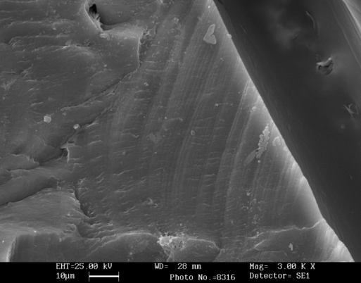
Evidence of fatigue
If fatigue occurs failure surfaces exhibit fatigue striations
Purely a design issue
Failure will be through the plane of the carrier cloth
Carrier cloth fibre
Striations
3000x
Photo courtesy Patrick Conor DTA NZ
©Adhesion Associates Mar 2016 Revision 1.0

Slide 39
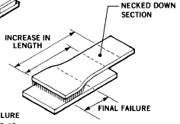
Fatigue testing adhesives
Fatigue testing will NOT validate bond processes
Testing short overlap specimens is meaningless (ASTM D3166/D1002)
  Entire joint may exhibit fully plastic behaviour, skews results
End of joint sees ductile yielding
  High strains in adherends ➔ high shear strains in adhesive
  Fails from ductile behaviour of adherends, not adhesive fatigue
Large overlap, thin adherends, failure is outside joint not through the adhesive
©Adhesion Associates Mar 2016 Revision 1.0
Notes:
Many organizations undertake fatigue assessments of adhesives using the short-overlap strength test specimen as specified by ASTM D3166 which uses the specimen from ASTM D1002. In such short overlap specimens, the adhesive may become fully plastic and this will have a direct influence on the results because fully plastic adhesive joints are susceptible to creep and fatigue damage of the adhesive. In realistic joints with longer overlap lengths, the elastic trough provides a mechanism for some creep recovery so the fatigue performance is significantly better than for short overlap joints.
Another factor which strongly influences test results for short overlap joints is that the highest loads in the joint occur in the adherends at the ends of the joint. These high stresses often result in fatigue of the adherends leading to ductile yielding prior to the onset of fatigue failure of the adherend. In many cases, the high strains in the adherends cause extremely high shear strains in the adhesive layer, and these high strains may initiate cohesion failure of the adhesive layer. It must be understood that such failures are as a result of the fatigue performance of the adherends, not the adhesive.
For joints with an adequate overlap length and an adequate load capacity, the failure will always occur in the adherends outside the joint. The adhesive will not fail.
Hart-Smith, L.J, Adhesive Bonded Joints for Composites – Phenomenological Considerations, Technologies Conferences Associates Conference on Advanced Composites Technology, El Segundo, CA, 14-16 Mar 1978.

Slide 40
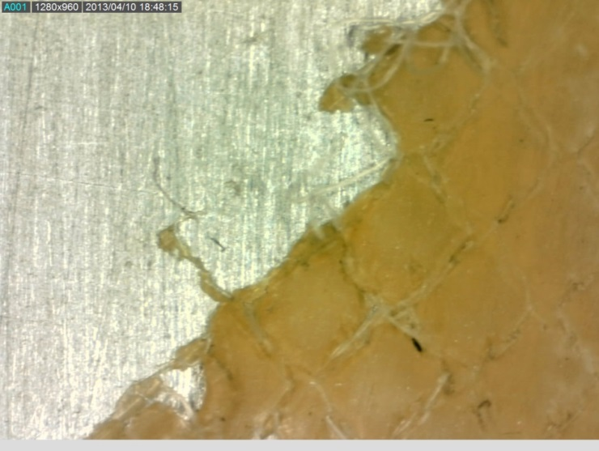
ADHESION FAILURE
Fully hydrated bond
  Very weak
  Fails at interface
NDI can ONLY find disbonds after they occur
  Strength is significantly lower than certification tests
NOT load related
  Some disbonds reported with zero flight hours
DTA inappropriate- adhesive adjacent to defect is weak
Required strength
NDI effective
Strength
DTA
inappropriate
Adhesion
failure
Time
©Adhesion Associates Mar 2016 Revision 1.0

Slide 41
Adhesion failure: causes
Two causes
  Contamination
    Obvious after short service
  Interfacial degradation in service (metals)
    Apparent after longer exposure to environment
Load capability is very low (→ zero)
Prevented by hydration-resistant surface preparation processes
©Adhesion Associates Mar 2016 Revision 1.0

Slide 42
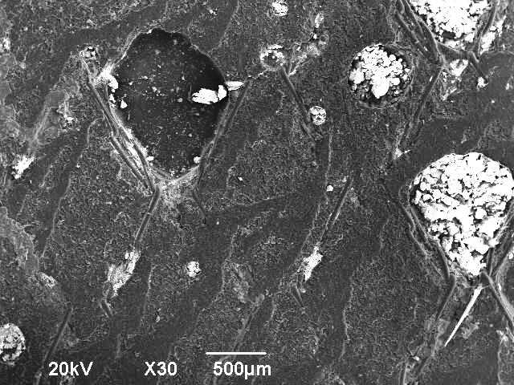
MIXED-MODE FAILURE
Partially hydrated bond
  Some adhesion/cohesion failure
  Fails away from carrier cloth
Fails before interface fully degrades
  Reduced strength
Apparent
Cohesion
Adhesion
Required strength
Failure may occur without pre-existing disbond
  Not detected by NDI
  DTA ineffective
Structure IS certainly weaker
Strength
NDI DTA ineffective
Mixed
mode
failure
Time
©Adhesion Associates Mar 2016 Revision 1.0

Slide 43
Explaining mixed-mode failures
Cohesion failure occurs through carrier cloth
As interface degrades:
  Mixed-mode failure occurs towards interface
  Strength reduces
Eventually adhesion failure occurs at interface
  Very weak
Safety investigators note:
  Thin residue of adhesive on surfaces does NOT mean strong cohesion failure
e. Adhesion failure; very weak
©Adhesion Associates Mar 2016 Revision 1.0

Slide 44
Preventing adhesion and mixed-mode failures (metals)
Adhesion and mixed-mode failures are avoided by hydration resistant interfacial chemical bonds
  Depends totally on the method used to prepare the surface for bonding
Most effective means to demonstrate: wedge test ASTM D3762
Acceptance criteria (TTCP Action Group 13) in DOT/FAA/AR – TN06/57 Best Practice in Adhesive Bonded Structures and Repairs
  FAA has project to re-draft the ASTM standard
Bonds meeting these requirements have a demonstrated history
  RAAF twenty years < 0.07% bond failures (technician malfunctions)
  USAF fourteen years no failures reported
Some OEM processes will not meet these requirements
Many SRM repair methods are also deficient
©Adhesion Associates Mar 2016 Revision 1.0

Slide 45
Fibre-composite interfaces
The discussion to date specifically refers to METAL bonds
Fibre composite interfaces rely on covalent bonds formed at the time of adhesive/resin cure
Hydration may play a role in interfacial degradation
Another possible cause for co-cure or co-bonded joints may be differential cure due to depletion of curing agents by one of the resin or adhesive systems
Another common cause of interfacial failures in composite joints is the use of peel plies
©Adhesion Associates Mar 2016 Revision 1.0

Slide 46
Peel plies
Peel plies are removable material incorporated on outer surfaces during laminate cure
  Protects laminate from contaminants
  Removal just prior to bonding removes surface contaminants
The peel ply must not form strong bonds to the laminate resin or removal may damage the laminate
Two mechanisms:
  Coat fibres with release material
  Heat scour fibres to glaze the fibre surface
©Adhesion Associates Mar 2016 Revision 1.0

Slide 47
Peel plies
Coated fibre peel plies will transfer release material to the supposedly clean surface
  Will result in lower strength bond
Heat scoured fibres form a cast of the glazed surface, which also will only bond weakly
Recommendation:
  Use heat scoured materials and then lightly grit-blast after removing the peel ply – do NOT solvent clean after grit blasting
©Adhesion Associates Mar 2016 Revision 1.0

Slide 48
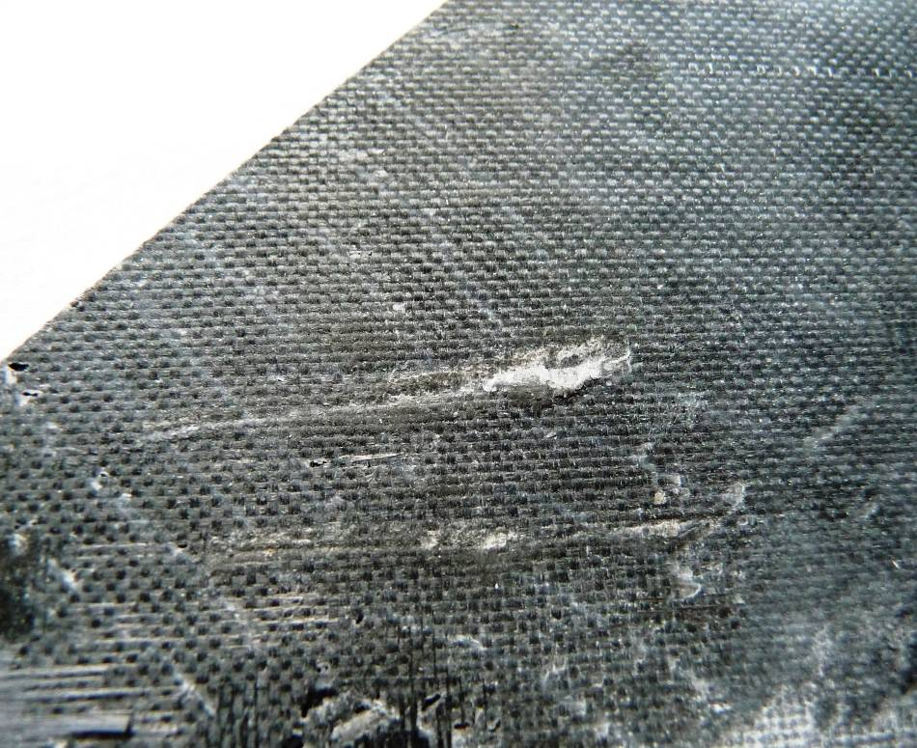
Case study: failure of composite bond
Bond used RT curing paste adhesive to secondary bond components
Preparation used peel ply only
  Heat scoured peel ply
  No abrasion
Joints failed with 95% adhesion failure evident
Company suspected contamination of surfaces
Adhesion Associates suggested tests to confirm or deny contaminants
©Adhesion Associates Mar 2016 Revision 1.0
Notes:
In this example, a non-aeronautical structure was bonded using a room temperature curing paste adhesive after removal of a heat-scoured peel ply. No additional treatment was undertaken. The joint failed with about 95% adhesion failure. The company proposed a large program to assess materials from the bonding facility to identify potential causes for contamination. Adhesion Associates proposed an initial assessment to verify that the surface had been contaminated.

Slide 49
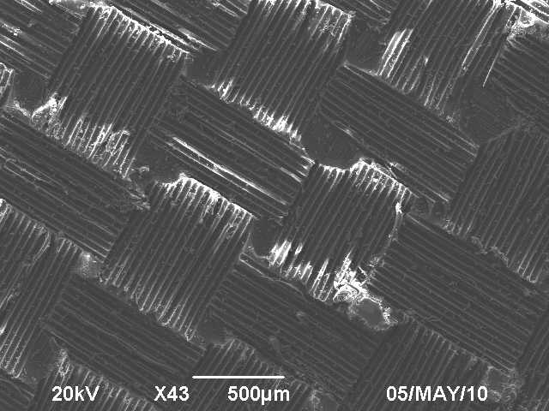
Case study (cont’d): SEM analysis
Peel ply impression replicated on bonding surface
Examination showed adhesive only at fiber cross-over points
No bond to resin elsewhere
EDAX used to investigate surface
Then surface ply removed and EDAX repeated on resin
Some slight differences indicated negligible contamination
  Cause of failure was NOT contamination:
  No abrasion step:- peel ply left slick surface with poor bonding
©Adhesion Associates Mar 2016 Revision 1.0
Notes:
A quick SEM inspection of the surface confirmed that the surface exhibited the impression of the peel ply with minimal residual adhesive located only at the points where the peel ply fibers crossed over. There was no residual adhesive anywhere else over the surface.
The approach used to assess the presence of contamination relied on EDAX examination of the surface, followed by removal of the surface resin and re-examination of the freshly exposed surface. A comparison of the results would confirm or deny the presence of contamination on the surface. While there were some slight differences, there was no clear evidence of extensive contamination, especially from silicone materials. The conclusion drawn was that the slick surface cast into the composite and the absence of a step to produce a chemically active surface led to weak bonding.

Slide 50
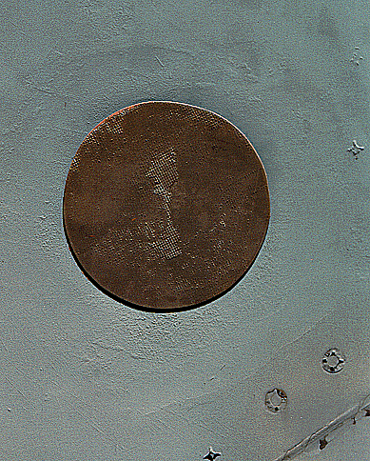
Case study: failed composite patch
Disbonded patch on aircraft
  Applied using SRM procedures
  Interfacial failure
    All adhesive left on surface
  Some voids in bond-line
Causes:
  Silicone peel ply on patch
  No instruction in SRM to remove peel ply
©Adhesion Associates Mar 2016 Revision 1.0
Notes:
This example shows the surface where a patch was applied during manufacture of a RAAF F/A-18 aircraft. The surface shows a neat, clean failure at the interface between the adhesive and the patch. This failure exemplifies the error of reliance on peel plies as the only surface preparation for adhesive bonding.
Peel plies are a sacrificial layer added during fabrication of a composite. They are removed just before bonding, allegedly taking with them all surface contamination. In practice, peel plies require a release treatment so that they themselves can be removed. The most common form of release mechanism is to treat the fibers in the peel ply with a release agent. Experimental data clearly shows that this release agent transfers to the bonding surface, causing gross contamination and poor durability.
The only form of peel ply which does not cause contamination is the heat scoured system, where the fibers in the peel ply are glazed in a gas discharge. The glazed fibers do not bond to the resin system. Unfortunately, the cast replicate of the glazed surface in the resin system produced by removal of the peel ply also does not bond for the same reason. Unless the surface is chemically active, the adhesive will not bond.
In the case above there may have been extenuating circumstances which caused the patch to fall off. There was no instruction in the repair manual to remove the peel ply, and it may have caused the patch to separate from the repair site.

Slide 51
Damage tolerance of adhesive bonds
FAR 2x.573 requires demonstration of damage tolerance
Standard methodology is analysis and testing based on artificial defects
  FEA: disconnect nodes to simulate a disbond
  Testing: use Teflon inserts to prevent bonding, then test
Local bond strength adjacent to defect is assumed pristine
  Failure would be by cohesion – high strength
Assumed cohesion failure
Local Adhesive Strength
Artificial defects
Load capability is the area under the curve
Note the area under this curve and compare with the next slide
©Adhesion Associates Mar 2016 Revision 1.0

Slide 52
Real bond defects
Ends of joint may degrade
  Failure will be weak adhesion
Centre of joint is not degraded
  Cohesion failure at full local strength
Transition zone has varying bond strength
  Failure will be mixed mode
Load capability (area under curve) is significantly less than modelled by artificial defects
CONCLUSION: Current DTA and NDI methods unconservative because adhesive adjacent to defect is NOT pristine
Un-degraded: Cohesion
Mixed-mode
Adhesion
Local Adhesive Strength
Disbond
Weak bond
©Adhesion Associates Mar 2016 Revision 1.0

Slide 53
Degraded interface and short overlap
Un-degraded here: Cohesion
Fully degraded: NO COHESION
Mixed-mode
Adhesion
Mixed-mode
Adhesion
Local Adhesive Strength
Full Overlap
Shorter Overlap
Local Adhesive Strength
Disbond
Weak bond
Disbond
Weak bond
Fully degraded
As overlap decreases, cohesion failure zone reduces
So does load capability
For very short overlap, load capability may be compromised
Failure may occur even without any detectable disbond
Short Overlap
Weak bond
NO disbond
©Adhesion Associates Mar 2016 Revision 1.0

Slide 54
Limitations of NDI for adhesive bonds
DTA of adhesive bonds requires effective NDI
Current NDI depends directly on detecting air gaps
  Can not assess the integrity of the adhesive-to-adherend interface: No air gaps
Current NDI can not assess bond strength
  Double-sided adhesive tape will pass the “tap” test
Can only find an in-service defect after disbonding has commenced
Failure of a degraded bond in short overlap joints may occur without a detectable disbond even being present
©Adhesion Associates Mar 2016 Revision 1.0

Slide 55
Let’s be clear
Regulations, DTA assume cohesion failure
Current NDI only finds disbonds after complete separation
  If structure has not already failed from low bond load capacity
DTA and NDI ineffective for adhesion, mixed-mode failures
  Also true for bond porosity
There is a real risk to continuing airworthiness by applying DTA to these defects
Cohesion
Effective
bond
Required strength
Strength
NDI and DTA ineffective
Mixed
mode
Adhesion
Operating
loads
Time
©Adhesion Associates Mar 2016 Revision 1.0
Notes:
To summarize: The current regulations and damage tolerance approaches assume that any bond failure will be by cohesion fracture of the adhesive. NDI can only find macro-voids after production and adhesion failure after disbonding has commenced and hopefully before the low strength of the remaining bond leads to total bond failure. Hence, damage tolerance and NDI are ineffective in preventing mixed-mode failures.

Slide 56
Case study: helicopter crash
Aircraft tracking to pick up tourists in tropical location
Experienced pilot only occupant
Clear day, light winds, approx. 500 ft ASL
One blade departs plane of rotation, multiple strikes on fin and boom, aircraft crashed into sea, pilot deceased
Investigator eliminated other causes except for failure of main rotor blade
©Adhesion Associates Mar 2016 Revision 1.0

Slide 57
Inspection history
Blade had been inspected several times within 80hrs before crash
  Scheduled servicing: Tap tested as per AD and SRM
  Unscheduled servicing 17 hrs later: Tap tested: Defect found within SRM limits
    Not located in subsequent bond failure sites
    No defects were found in skin-to-spar bonds
  Scheduled service 33 hrs later: visual inspection as per AD: known defect tapped
  Aircraft crashed 30 hrs later
~17 hrs
~50 hrs
~80 hrs
Service Time (hrs)
Scheduled service
VISUAL INSPECTION, TAPPED KNOWN DEFECTS
Unscheduled inspection
TAP TESTED
Scheduled service
TAP TESTED
CRASH EVENT
©Adhesion Associates Mar 2016 Revision 1.0

Slide 58
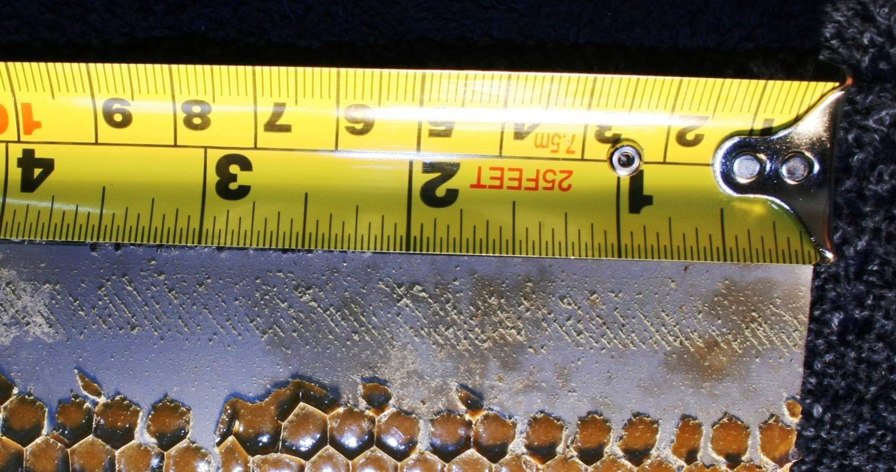
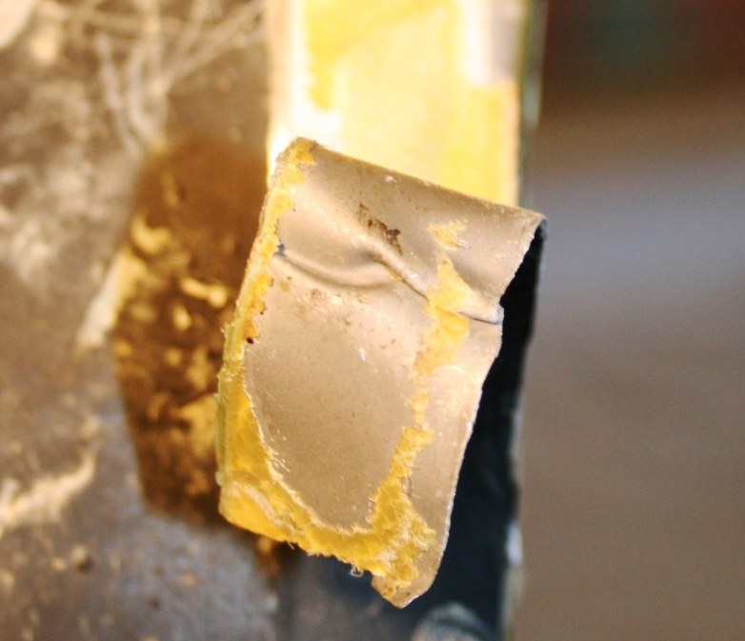
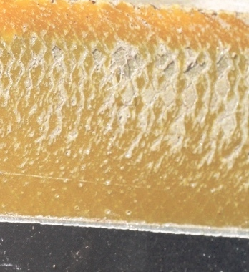
Case study: helicopter crash
Large proportion of mixed-mode and adhesion failure
Minimal (no?) cohesion failure
Examples of total adhesion failure
Would be substantially weaker than original manufacture
©Adhesion Associates Mar 2016 Revision 1.0

Slide 59
Case study: helicopter crash
Can not definitively state bond failure caused the crash
  Causal/consequential mixed-mode failures difficult to separate
Equally not possible to exclude weak bond strength as a significant factor
Parts of blade first items in debris path
Investigator concluded that in the absence of other causes, blade failure due to bond degradation was the most probable cause of the crash
Approved NDI methods appear not to have prevented failure of this structure
©Adhesion Associates Mar 2016 Revision 1.0

Slide 60
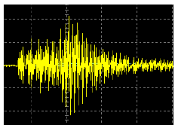
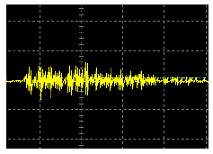
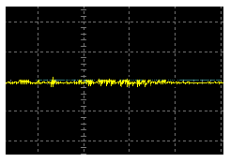
Future NDI for assessing bond strength
NDI and damage tolerance are limited by inability to assess bond load capability in the absence of defects
Research evaluating several methods (e.g. UT, holography)
Most research focusses on strength of uniformly degraded bonds
Some promise in finding local strength differences (UT)
Pristine bond
Partially weak bond
Fully weak bond
Through transmission A scan
Images courtesy D. Roach,
Sandia National Labs.
©Adhesion Associates Mar 2016 Revision 1.0

Slide 61
Correlation with real bonds
The UT signal corresponds with the anticipated failure modes in real bonds
Signal amplitude indicates local strength (NOT load capability)
There is a potential to use the correlation between signal amplitude and bond condition to actually provide an estimate of bond load capability
Un-degraded: Cohesion
Mixed-mode
Adhesion
Local Adhesive Strength
Local Adhesive Strength
Disbond
Weak bond
©Adhesion Associates Mar 2016 Revision 1.0

Slide 62
Sandwich panel service defects
Cohesion, adhesion and mixed-mode failures may occur in bonded sandwich structure
Failures may occur
  Skin-to-adhesive
  Adhesive to core
  Core node bonds
Skin
-
to
-
adhesive
Core fillet bond
Face sheet
disbond
Adhesive
Adhesion fillet bond failure
Core
Cohesion fillet bond failure
Core node bond
Weak node bond failure
Strong node bond failure
Notes:
There are three basic bonds within a sandwich panel: the bond between the skin and the adhesive; the bond between the adhesive and the core; and the adhesive bonds typically used to manufacture the honeycomb core itself.
All of these can exhibit bond failures.
Each of these failure types will be discussed in the following slides.

Slide 63
Sandwich panel production defects
Core to edge member gaps, voids in foaming adhesive at edge members, incomplete core splice, gaps at machined steps, incorrect ribbon direction
Loss in strength shown
Gap
>30%
Wrong ribbon
direction < 10%
Void
>30%
Incomplete core splice
< 10%
Gap at machined step
10% to 30%
Notes:
Sandwich panel production defects are shown on this slide. Typical defects are: core to edge member gaps; voids in foaming adhesive at edge members; incomplete core splice; gaps at machined steps within the structure; or incorrect ribbon direction. The loss of strength is shown in this figure. Of interest, the edge member is critical to the performance of the sandwich panel. Edge members are NOT there to simply provide environmental protection, they are there to transfer the shear loads from the top face to the bottom face and into the structure.
Of further interest, incomplete core splice has a minor effect, as does incorrect ribbon direction.
Reference: Burkes, J.M., Griffin, M.A., and Parr, C.H., Performance of Aluminum Honeycomb Panels with Structural Defects and Core Anomalies, SAMPE Journal, Vol. 28, No. 2, March/April 1992.

Slide 64
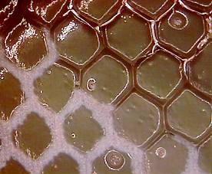
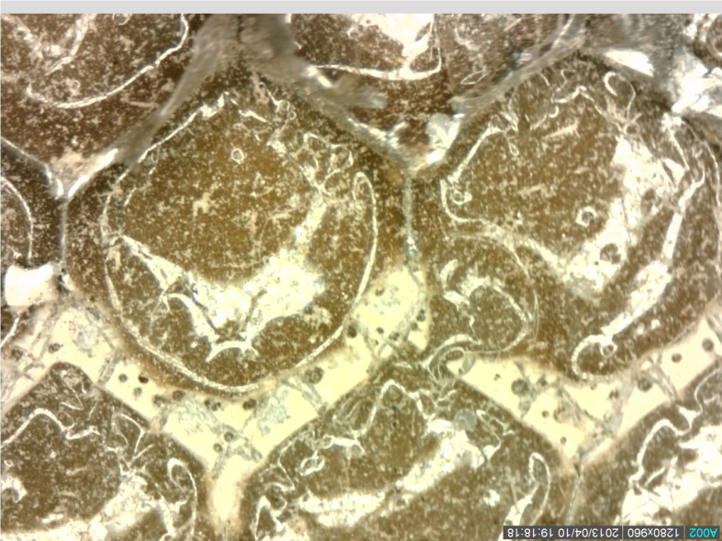
Cohesion failure
Adhesive fractures or core tears
Usually due to overload or internal pressure
Found using ultrasonics
Core cell wall
fracture
Cohesion fillet
bond failure
Notes:
Cohesion failure of a sandwich panel structure typically results in fracture of the adhesive, or torn core.
These are usually due to overload or internal pressure, commonly caused by moisture within the panel during repair.
Typically, these are found by use of ultrasonics, although quite often they are a high energy failure and as a consequence, they may be readily detected audibly at the time of occurrence.
They can be found using ultrasonics, a tap hammer, and it may be possible to re-bond the surface after solvent degreasing and abrasion.

Slide 65
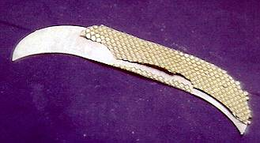
Adhesion failure
Adhesive separates at interface
Caused by poor or ineffective processing or slow heat-up rate
Detected using ultrasonics, tap test
Repair by re-manufacture using validated processes
Adhesive to skin disbond
Adhesive to core disbond
Notes:
Adhesion failure occurs where the adhesive separates at the interface. Typically, this is caused by poor or ineffective processing, or a slow heat-up rate. Quite often adhesion failures are detected by ultrasonics or tap testing. The only way to repair this type of failure is to re-manufacture using validated processes and correct heating procedures.

Slide 66
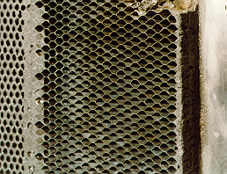
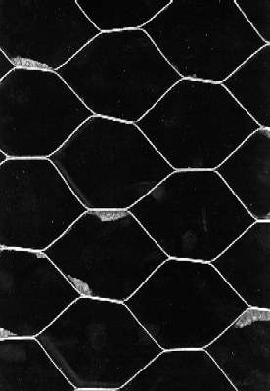
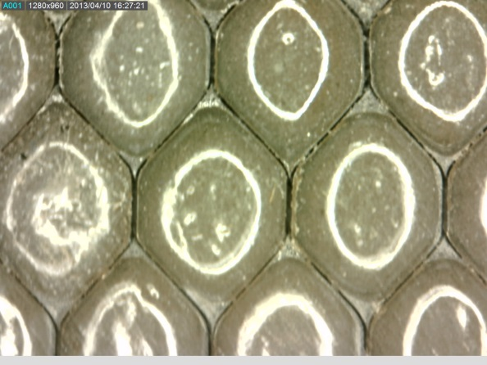
Adhesive-to-core adhesion disbond
Cohesion
Adhesion
Not well known
Adhesion failure between adhesive and core
Core appears intact, no fracture of adhesive
Microscope used to confirm absence of core in fillets
Difficult to detect by NDI
90% loss of FWT strength
USN has lost a large number of F/A-18 rudders
Do NOT bond to this core!
©Adhesion Associates Mar 2016 Revision 1.0
Notes:
Adhesive-to-core adhesion failures are characterized by a predominant absence of adhesive on the core cells, a predominant absence of damage on the adhesive surface. This failure mode may be confirmed by examination of the absence of core material in the adhesive surface, as shown in the photo on the lower right of the slide. It is possible to see right down the gap in the fillets so there is no core in the space where it should be bonded to the fillets.
The core cells simply “pull out” of the adhesive fillet bonds. The core appears intact and there is no damage to the adhesive. Examination using a 20-40x microscope is strongly recommended to confirm the absence of core material in the adhesive fillets. Adhesion Associates Pty Ltd has experienced one example where severe impact on the side of the core completely sheared the core from the adhesive at the surface, leaving just the adhesive. Only after microscopic examination was the residual core detected, confirming that this was NOT adhesion failure.
The fact that the core appears to be intact is not to be taken as an indication that bonding to this surface is acceptable. The core must be removed and replaced with a fresh core insert. This is because the surface of the core is highly oxidized – as a consequence, adhesive bonds will NOT be formed to the cell walls and adhesion failure will again occur.
These are quite difficult to detect because there is usually sufficient physical contact to pass ultra-sonic or tap hammer testing. However, this type of bond degradation has been shown to produce up to a ninety percent loss in flat-wise tensile strength for sandwich panels. As a consequence, the US Navy has lost at least twelve FA-18 rudders in flight because of this specific type of defect.
Repair of adhesion fillet bond failures by injection, again, is futile. The surface is NOT clean, the surface is NOT chemically active, and it WILL NOT form a proper, durable bond. All that’s achieved is the filling of the air gap such that tap testing will indicate a successful bond.
In the example shown, you can clearly see the impression of the previous bond which has been cast into the injected adhesive. This indicates, first of all, that the initial failure was an adhesion fillet bond failure, also that the injected adhesive DID NOT bond. Again, there is a second injection repair over the top of the first injection repair. In this particular case, the component departed the aircraft in flight, resulting in extensive damage to the aft end of the aircraft.

Slide 67
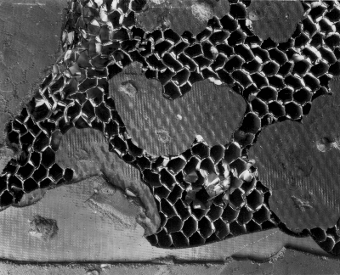
Case study: repair of adhesion fillet bond failure
Injection repair is futile
  Surface is not clean
  Surface is not chemically active
  Will not form bond
Gap is filled so passes tap test
Impression of adhesive evident
  Definitely adhesion fillet failure
  Injected adhesive did not bond
  Second injection did not work either
  Component failed in flight, extensive damage to aircraft
©Adhesion Associates Mar 2016 Revision 1.0
Notes:
In this example, fillet bond failure had occurred between the adhesive and the core. This is confirmed by the replication of the failure surface in the adhesive injected into the air gap. The repair can never achieve strength restoration because the fundamental requirements for adhesion do not exist. The surface is not clean and it is not chemically active.
In this case even after multiple attempts to repair this disbond, eventually the component failed and impacted the empennage damaging the vertical stabilizer leading edge, a horizontal stabilizer and the rudder.

Slide 68
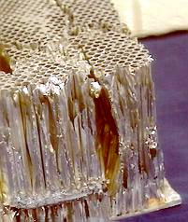

Blown core
Core is distorted, separates along ribbon direction
Caused by release of steam during heating (repair)
Detected by x-ray or visual detection of skin crease
Full depth core repair required
Notes:
Honeycomb cores which fail due to the presence of moisture within the panel during a heating procedure, typically fail in a high energy manner. The core is quite often distorted and separates along the ribbon direction. These are usually detected by x-ray, or may be visually detected by the presence of creases on the skin, if there is a thin skin. The only repair for such a defect is to remove all of the damaged core, perform a full depth core insert, and bond a repair over the access hole.

Slide 69
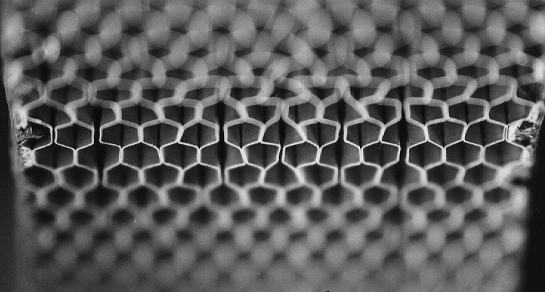
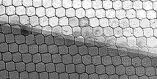
Core node bond adhesion failure
Cell walls separate along ribbon direction
Cell walls not distorted
Caused by water in cells
Detected by careful examination of x-ray image
Usually appears with adhesion fillet bond failure
Component shear integrity is severely degraded
Repair by core replacement
©Adhesion Associates Mar 2016 Revision 1.0
Notes:
A further type of failure that occurs in sandwich panels, is what is known as “weak node bond failure”. In weak node bond failures, adhesion failure occurs between the core, the adhesive used to manufacture the core, and the core cell walls. Typically, the cell walls are NOT distorted. This type of damage results from water entrapment in sandwich panels. It often occurs in conjunction with adhesion fillet bond failures. This type of defect can be found by careful examination of x-ray images, looking for the separation between the cell walls. Weak node bond failure usually occurs in areas where moisture is present; as a consequence, a more effective method is to look for the presence of water within the panel, then to examine the area around that water.
This type of defect results in a significant loss of shear strength. The ONLY repair for this type of damage is to remove the core and replace it.

Slide 70
Core-to-edge-member bonds
Bonds to edge members, helicopter spars etc. formed using foaming adhesive
Usually a trivial design case because adhesive strength is significantly higher than core shear strength
Failure of this bond can cause significant problems
Core strength ~100-200 psi, adhesive > 1000 psi
  Failure should be by core failure, leaving core attached to adhesive
Reference data shows strength loss may exceed 30%
©Adhesion Associates Mar 2016 Revision 1.0
Notes:
Core-to-edge-member or core to spar bonds are formed by applying an adhesive which contains a blowing agent. When heated, the adhesive expands to fill the gaps between the core and the edge member or spar. This bond is often ignored during analysis because the core shear strength is usually significantly lower than the shear strength of the adhesive. However, failure of this bond can lead to significant structural issues.
Burkes, J.M., Griffin, M.A., and Parr, C.H., Performance of Aluminium Honeycomb Panels with Structural Defects and Core Anomalies, SAMPE Journal, Vol. 28, No. 2, March/April 1992.

Slide 71
Conclusions
NDI and DTA may not prevent failure of these bonded joints:
  Adhesive bonds with extensive porosity
  Adhesive bonds experiencing interfacial degradation and with a short bond overlap
    No reserve load capability to enable detection of disbonds before the reduced joint load capability is exceeded by flight loads
Regular and on-going proof testing at limit load may be the only method for assurance of continuing airworthiness
  FAR 2x.573 Paragraph 5 (ii)
Tolerable defect sizes based on artificial defects in pristine bonds do not adequately represent adhesive bonds experiencing interfacial degradation
  NDI based on artificial defects may fail to meet the substantiation of limit load capability requirements of FAR 2x.573
©Adhesion Associates Mar 2016 Revision 1.0

Slide 72
Conclusions
Porosity and interfacial degradation directly related to production processes
  Can be prevented by:
    Elimination of sources of moisture prior to bonding
    Use of surface preparation processes which provide resistance to interfacial degradation
Elimination of interfacial degradation and bond porosity would significantly reduce ongoing NDI maintenance requirement
Current research programs may enable accurate assessment of bond load capability
  May be possible to more accurately manage damage tolerance of bonded structures
©Adhesion Associates Mar 2016 Revision 1.0

Slide 73
Question time
?
Notes:
Intentionally blank

Slide 74
How to measure load capability
Should be possible to measure load capability by integrating the peak signal amplitude along the overlap of the bond
  Calibrate signal against reference standards
  Scan along overlap length
  Integrate the signal amplitude along the overlap
  The value derived is the proportion of load capability of the bond
The measured load capability could then be assessed against limit load to establish airworthiness
Should also be effective for porosity and degrading bonds
Load capability of joint
Well bonded
Integrated signal as proportion of local strength
Degrading
Weak
Position along joint overlap

