Slide 1
Rules Update Programme (RUP)
Introduction to Technical Advisory Groups
Notes:
INTRODUCE YOURSELF! Your role in the RUP, key POC for TAGs, etc.

Slide 2

Purpose of this session
Overview of the programme, projects and timelines
Role of TAGs, including terms of reference
Next steps
Note: Today’s session is not an opportunity to discuss or debate the programme’s scope or the details of any particular project.

Slide 3


RUP snapshot
A focused programme of work to update rules over a two-year period.
Divided into 23 projects (including three ‘quick wins’, already well-advanced).
Projects chosen from a long list of issues, prioritised according to nine criteria.
Each project may amend one or more rule parts. Some rule parts will be amended several times during the programme.
CAA and MoT have additional resource for the duration of the programme.

Slide 4
Sector engagement approach
Policy investigation
Rule development
Rule finalisation
All projects:
Technical Advisory Groups
Engagement with selected relevant organisations
Selected projects:
Information sessions
Discussion documents
All projects:
Formal consultation
CAA website: key information about projects and progress throughout the programme
Aviation.govt.nz/rules-update-programme
Notes:
Use of information sessions and discussion documents will depend on project complexity.

Slide 5
Overview of projects

Slide 6
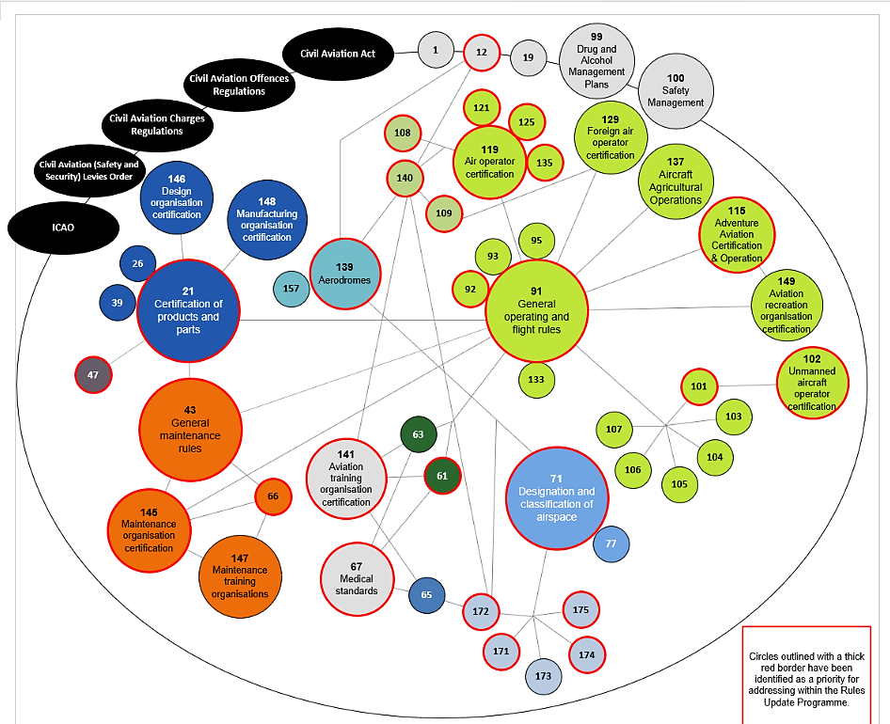


Slide 7
Current programme timeline
Category | Project Content | 2025 | 2026 |  |  |  | 2027 |  |  |  | 2028
 |  | Oct-Dec | Jan-Mar | Apr-Jun | Jul-Sep | Oct-Dec | Jan-Mar | Apr-Jun | Jul-Sep | Oct-Dec | BAU
2025 Quick Win | Part 115 – aviation adventure operations
2025 Quick Win | Part 91 – modern navigation & comms equipment
2025 Quick Win | Part 139 – runway end safety areas (RESA) and engineered materials arresting systems (EMAS)
ICAO Safety Audit | ICAO Safety Audit Group 1 – flight training, medical certification, air operations
ICAO Security Audit | Parts 108/140/109 – Annex 17 alignment (cargo and training)
Economic Benefit | Parts 21 & 145 – recognition of foreign regulatory frameworks for certification and maintenance
Economic Benefit | Investigation into better enabling agricultural drone use
ICAO Safety Audit | ICAO Safety Audit Group 2 – aircraft maintenance, airworthiness, and air navigation
ICAO Security Audit | Cybersecurity – ICAO alignment
Modernisation | Complete review of Part 61: Pilot Licences and Ratings
Modernisation | Parts 171/172 – review air navigation services and navigational aids
ICAO Security Audit | Parts 108/140 – aircraft security search
ICAO Alignment | Parts 101/102 – alignment with ICAO drone standards
Modernisation | Part 66 – review of Licensing Aircraft Maintenance Engineers (LAME)
ICAO Alignment | Part 92 – dangerous goods review
Economic Benefit | Part 91 – portable electronic devices & lithium batteries
Modernisation | Part 91 – general rule structure & content update
ICAO Alignment | ICAO alignment – specific weather issues (windshear)
Economic Benefit | Parts 139/140 – security tiers and differential equipment standards
ICAO Alignment | Part 139 – ICAO alignment – runway strip width
Economic Benefit | Part 21 – aircraft products and parts review and update
Modernisation | Part 101 – review of requirements for small rockets
Economic Benefit | Part 102 – oversight of uncrewed aircraft systems (UAS) aerodromes
Key: Project size
Small | Large
Medium | Extra large
Notes:
CAVEAT: project timelines are indicative – may change once the detailed project scope is determined in the earliest phases

Slide 8
All about TAGs
Purpose and scope
Input
Out of scope
Differences across projects
Transparency

Slide 9
Purpose and scope
To provide CAA with
  independent technical expertise
  operational knowledge
  practical industry experience
to support the development of
  regulatory policy
  rules
  related guidance under the Civil Aviation Act 2023 for a project.
A Technical Advisory Group exists to:
Strengthen the evidence base for policy and rule development by drawing on specialised technical, operational, and sector-specific insights.
Test the practicality, feasibility, and workability of proposed regulatory options.
Identify risks, opportunities, and unintended consequences early in the regulatory design process.
Highlight sector impacts, including operational constraints, compliance implications, economic considerations, and transition requirements.
Help the CAA ensure that regulatory proposals are technically sound, proportionate, and effective, while aligned with best practice and international aviation standards.

Slide 10
Input may focus on
Problem definition and context
Options development and assessment
Safety, risk, and performance impacts
Implementation and transition
International alignment and benchmarking

Slide 11
Out of scope
A TAG does not:
Negotiate or agree the content of proposed rules or policy decisions
Act as a substitute for broader public consultation, regulatory impact analysis, or Ministerial decision-making
Represent organisational or commercial interests in an advocacy capacity
Develop draft legal rule text, including the drafting of Notices of Proposed Rulemaking (NPRMs)
Provide input on matters unrelated to the defined project scope
Provide operational approvals, exemptions, or certification decisions
Notes:
The purpose of the TAG is not to seek consensus or collective agreement. Individual TAG members provide individual technical input, and differing views may exist. It is the responsibility of CAA and MoT to assess this input and determine which views are appropriate in the context of the project.

Slide 12
Each TAG will be different
We’ll assemble the TAG for each project as it kicks off.
  Expertise needed: Determined by detailed project scope
  Who and how many: Influenced by subject complexity, timeline limitations
  How we’ll work: Based on project needs, schedules of members, and how members prefer to contribute (wherever feasible)
We may seek more information from you:
  More detail about your expertise
  Your availability over a specific period for the project
Notes:
We plan to be dynamic and will aim to be flexible, give plenty of time for thorough consideration, etc.
We’ll use a range of methods to gain insights from the TAGs, to enable members to contribute in an efficient way that suits their busy schedules. This may include in person or online workshops, surveys, and online discussion forums.

Slide 13
TAG transparency
Membership of TAGs and any contribution you make will become Official Information and will be released if requested, subject to any provisions for withholding information.
You will be required to consent to the release of your name and any contributions you have made at the outset of each TAG.

Slide 14
Next steps

Slide 15
What happens next
Terms Of Reference template will be circulated.
First tranche of projects – potential members contacted and specific TOR signed.
Future projects
  First call for more information – in the month leading up to a project starting
  Confirming membership – in early stages of project
  Key dates and details – asap after membership confirmed.
All information will come from RUP-TAGs@caa.govt.nz – please contact us via this email at any time .
General enquiries about the programme should be sent through our web page: Rules Update Programme.
People can express their interest in joining a TAG via the EOI form open on our web page throughout the programme. We’ll check weekly for new responses, so please feel free to circulate this offer to your networks.
You don’t have to be on multiple TAGs and you can opt out of a TAG, or consideration for future TAGs, at any time.

Slide 16
Questions?

