Slide 1
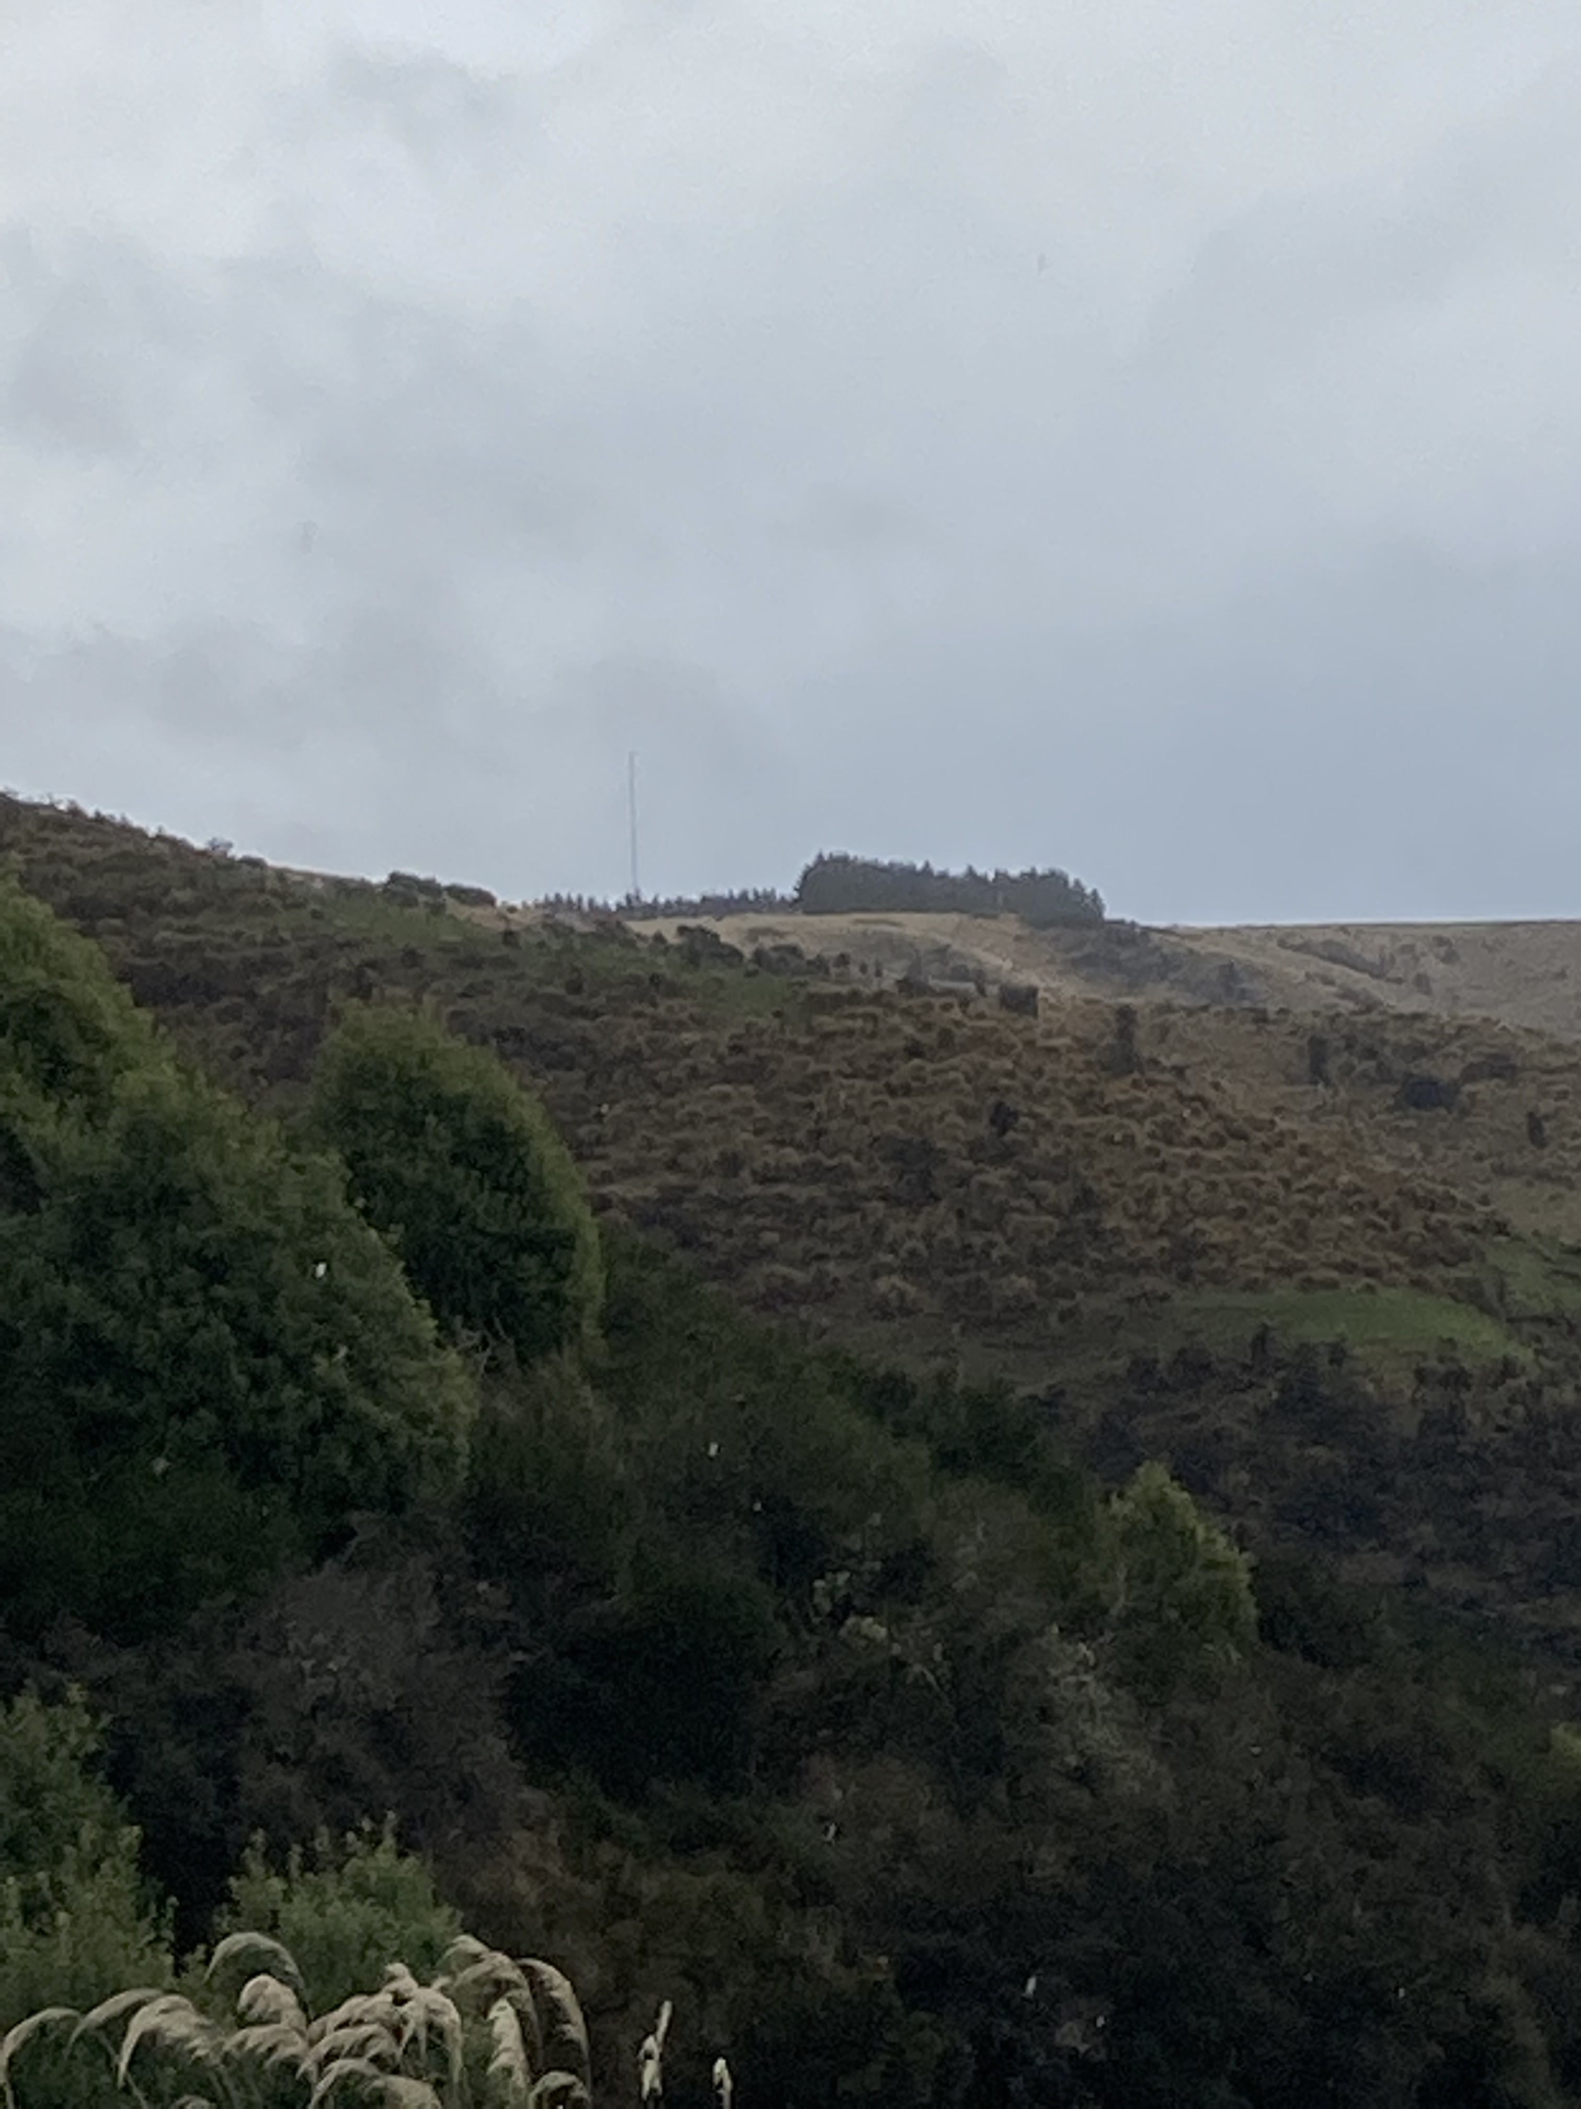

Anticipating “threats” during training
CAA Flight Instructor Seminars 2022

Slide 2
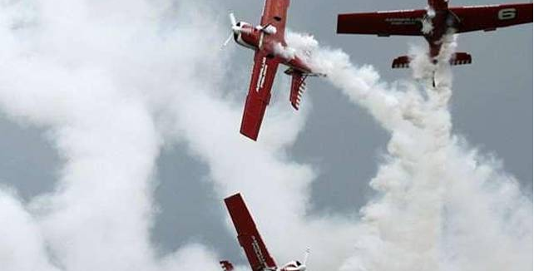
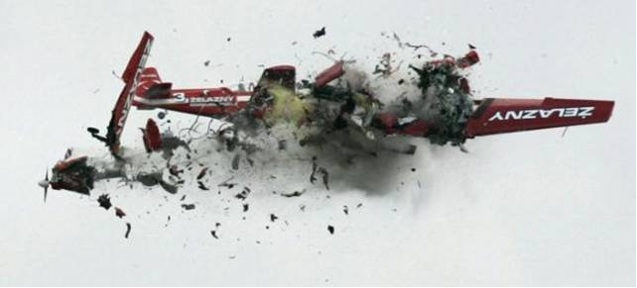
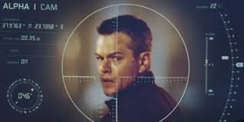
“Threat” and “Error”
Discussed together - two different, but related concepts
Acronym/attitude
Jason Bourne

Slide 3
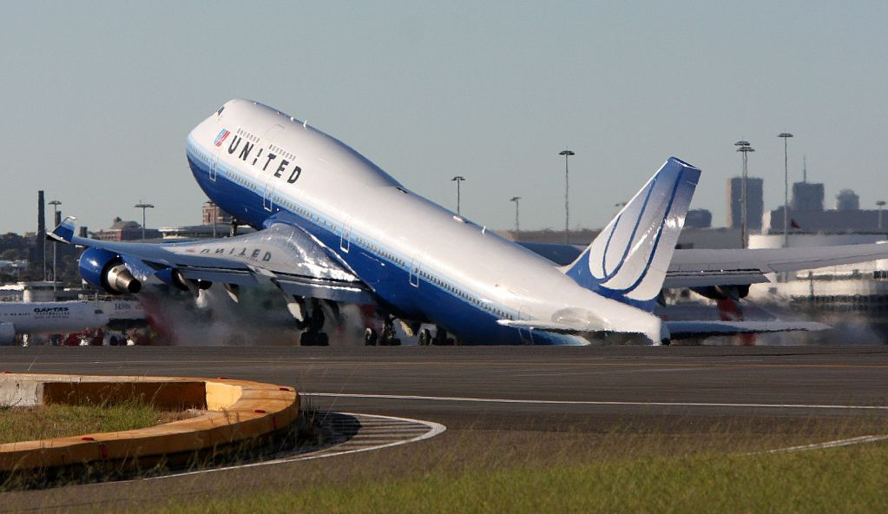
Error – mistake, inaccuracy or misjudgement
How we respond/learn

Slide 4
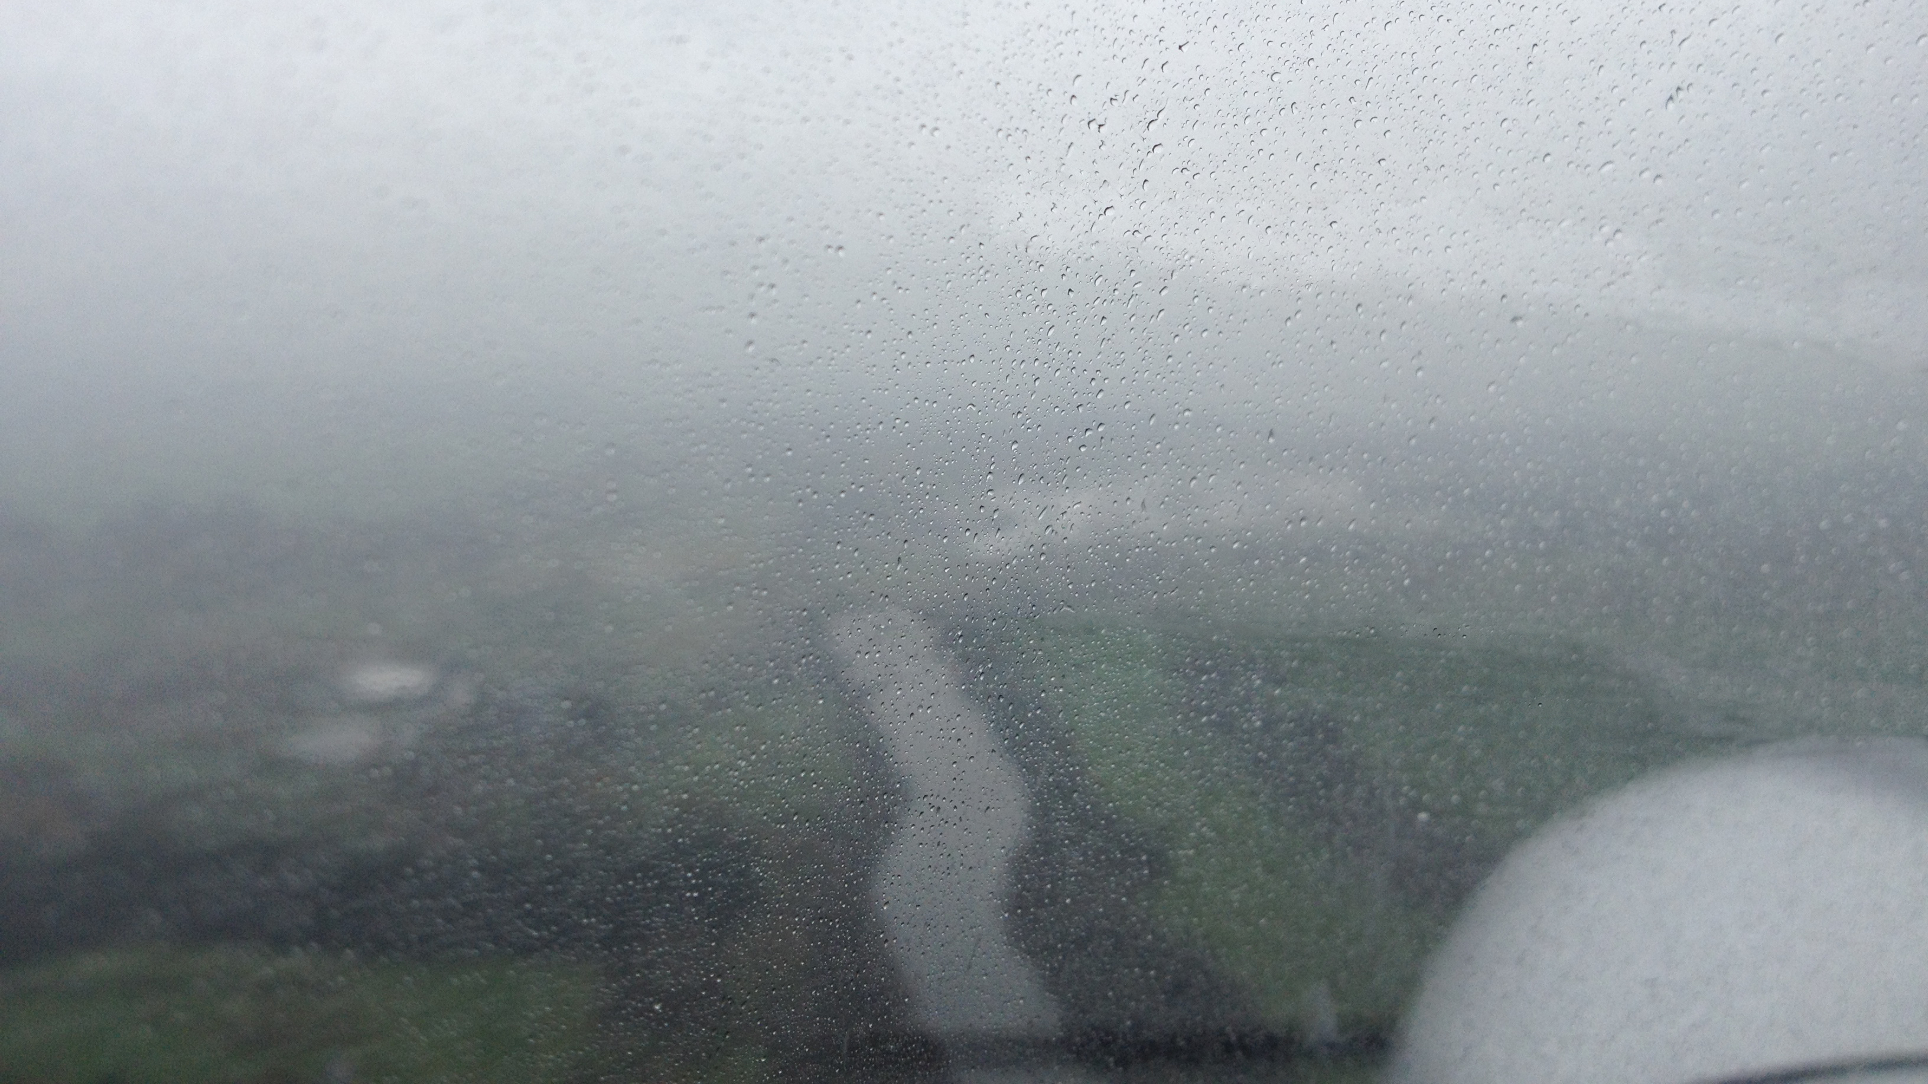
Focussing on threats – 6 scenarios
Forced landings
Precautionary landings
Cross country
Mountain flying
Landing/take-off
Standard overhead join

Slide 5
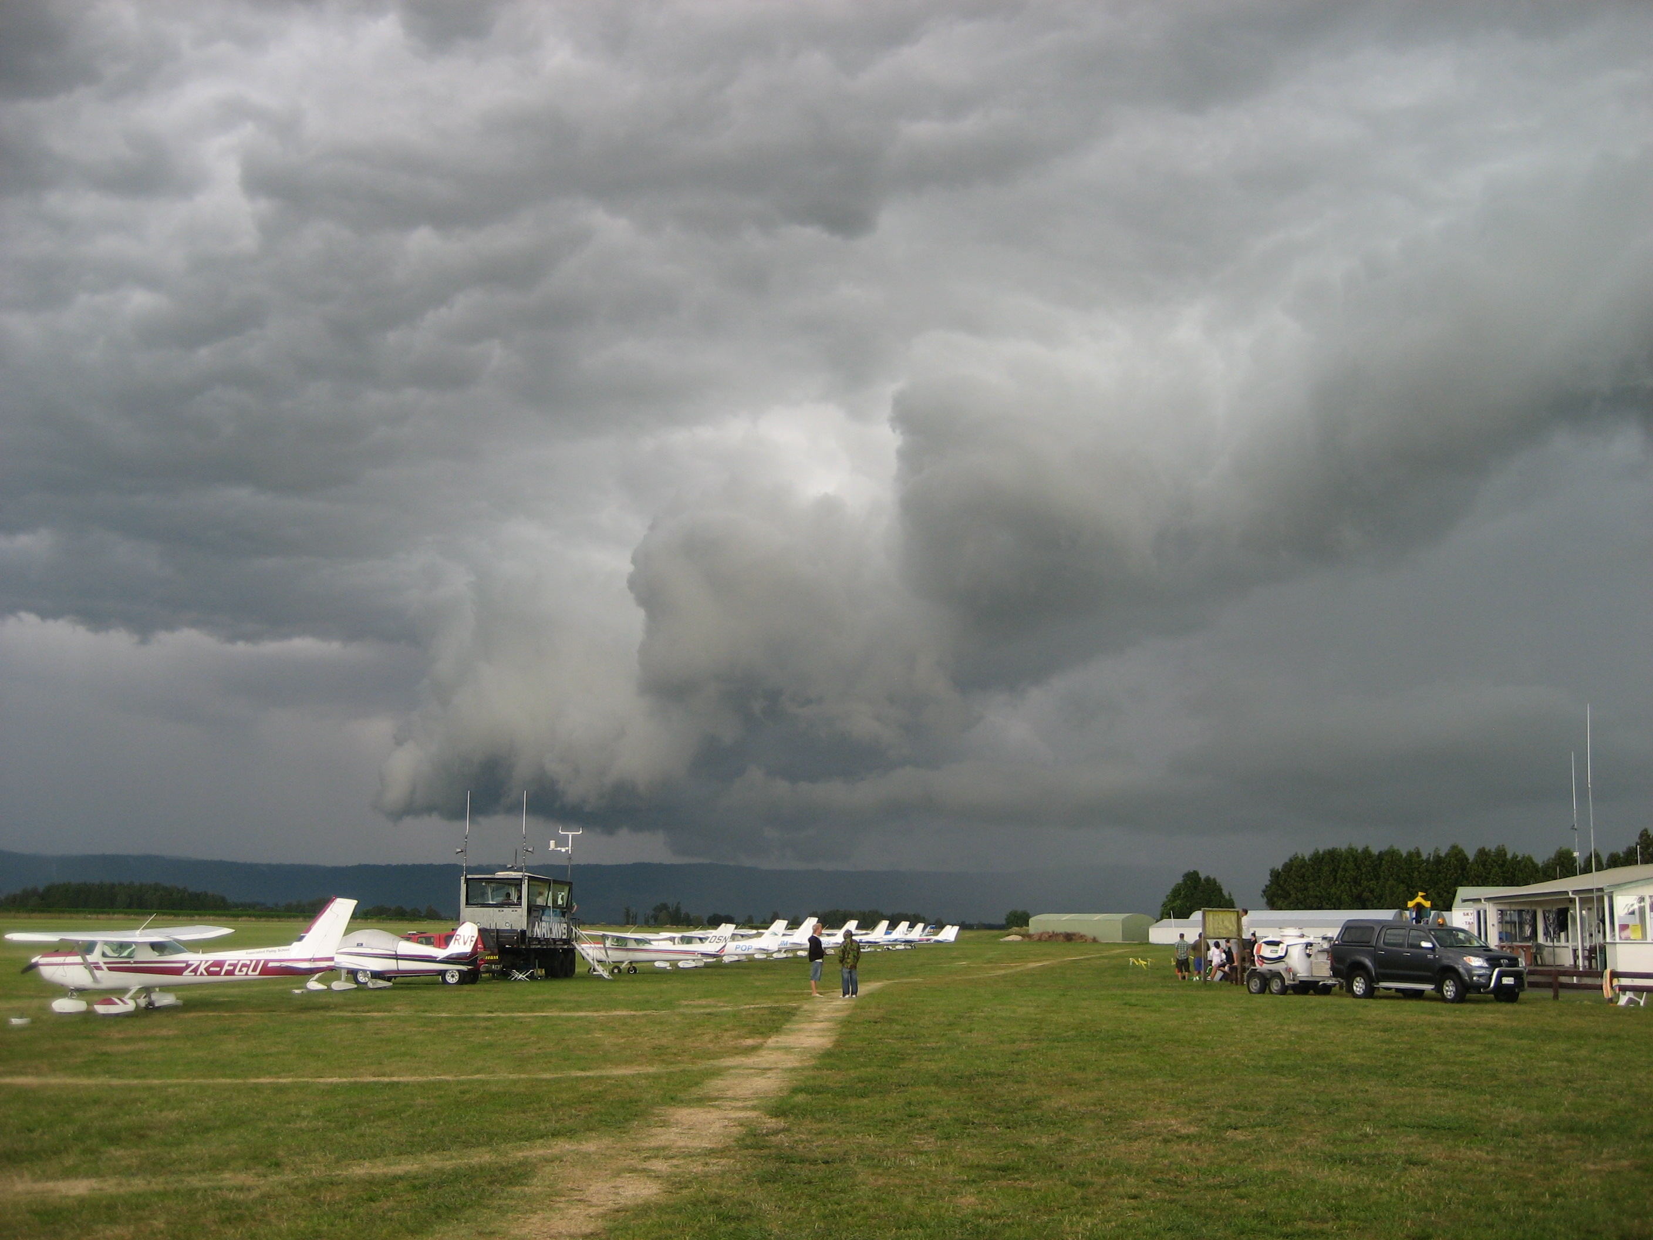
Threat – strong possibility of something dangerous or unpleasant happening
Threat- places aircraft or occupant(s) in unsafe or hazardous state
How we anticipate
How we mitigate

Slide 6
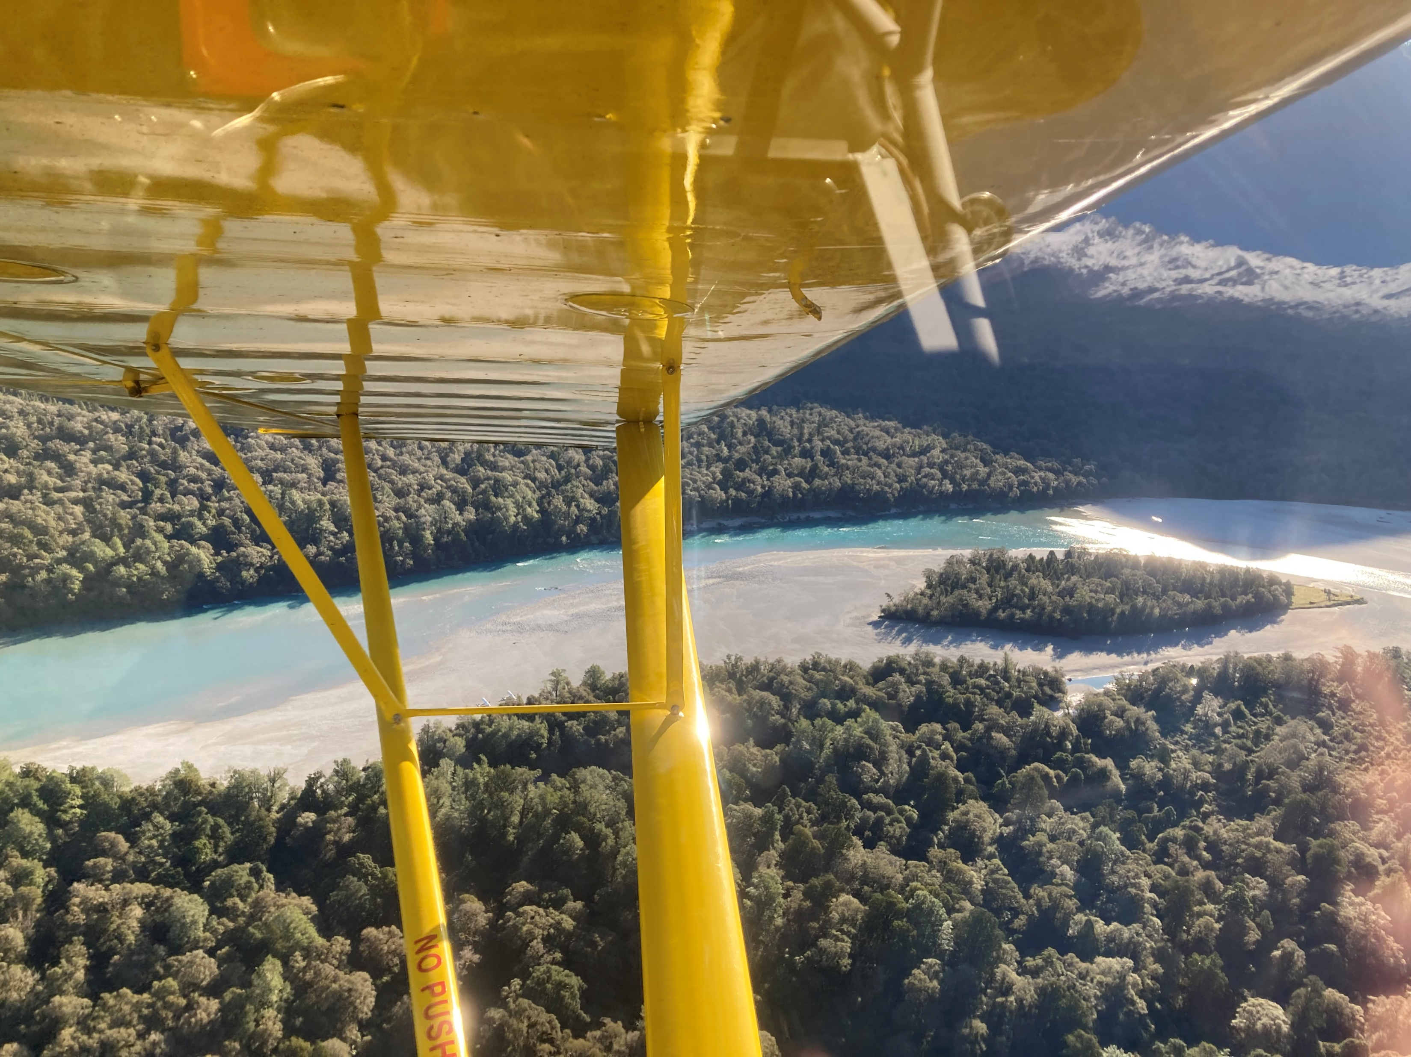
Simulated Forced Landings
wind
Size
slope
surrounds
stock
shape
surface
sun
elevation
communication

Slide 7
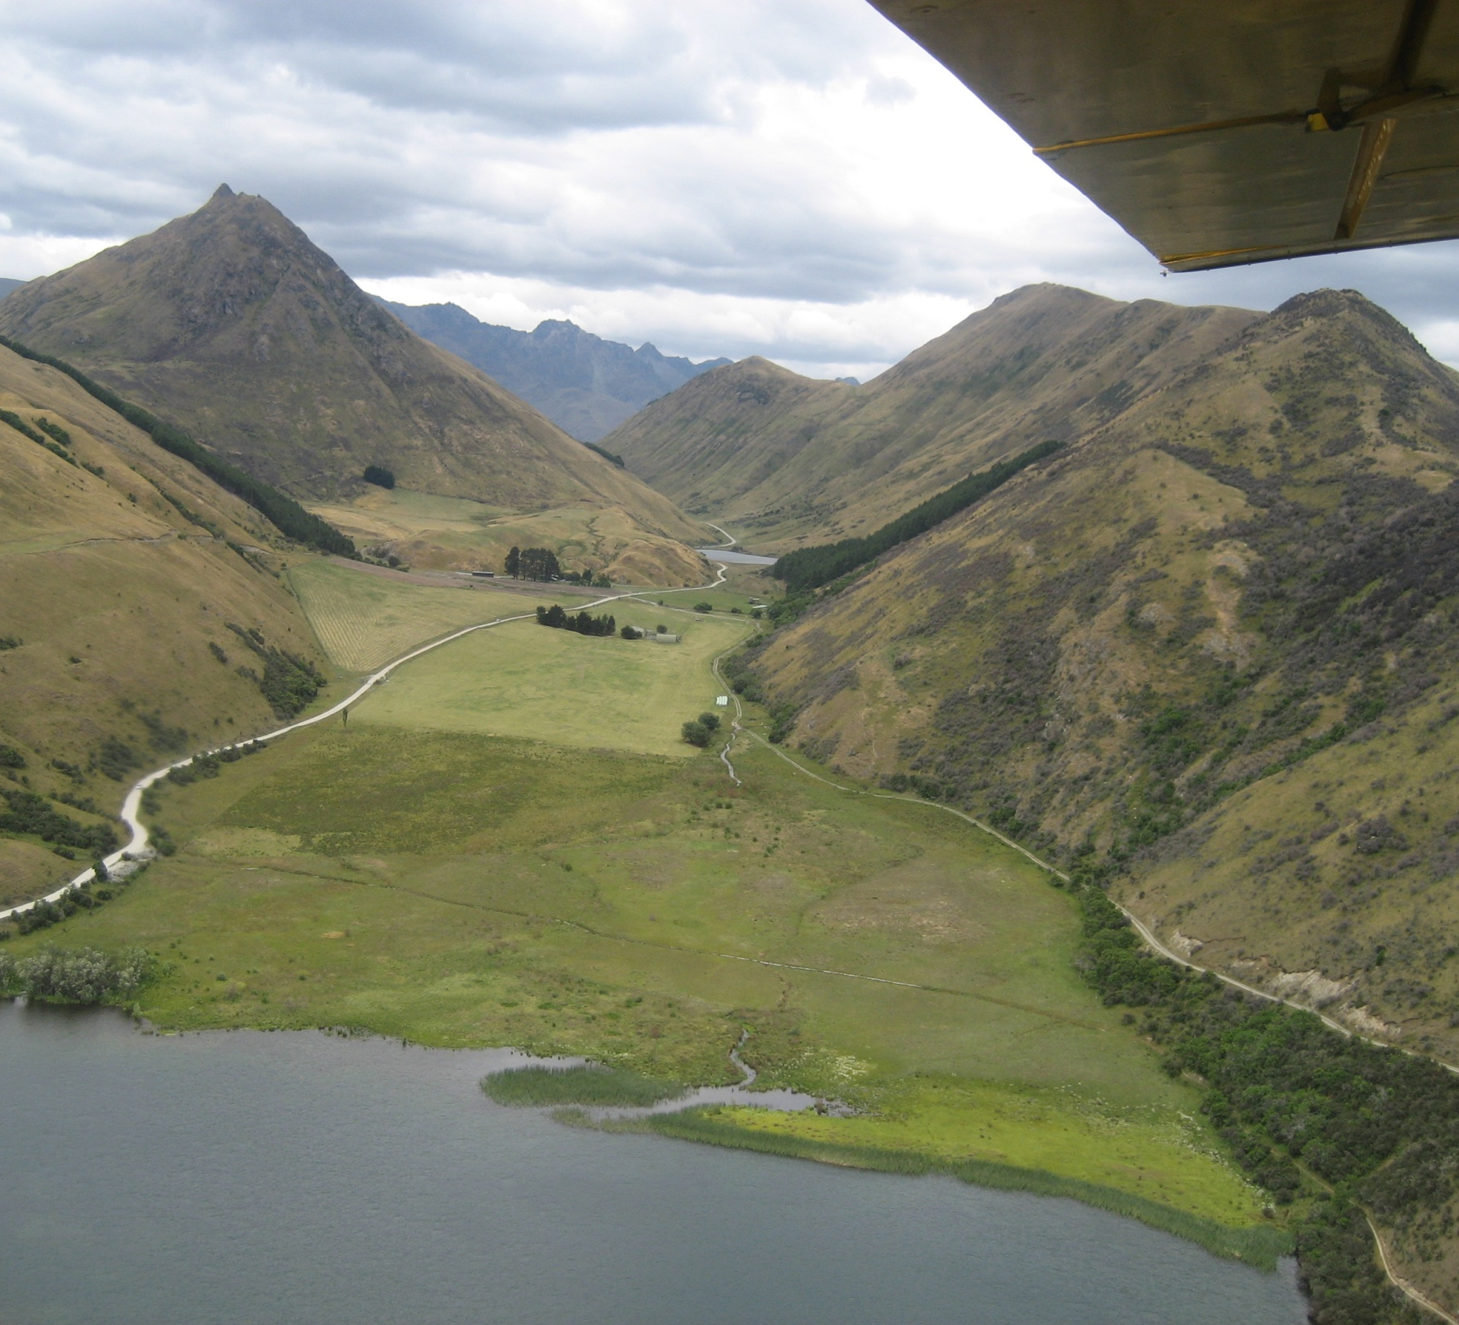
Precautionary Landings
Wind
Size
Shape
Slope
Surrounds
Surface
Sun
Stock
Elevation
Communication

Slide 8
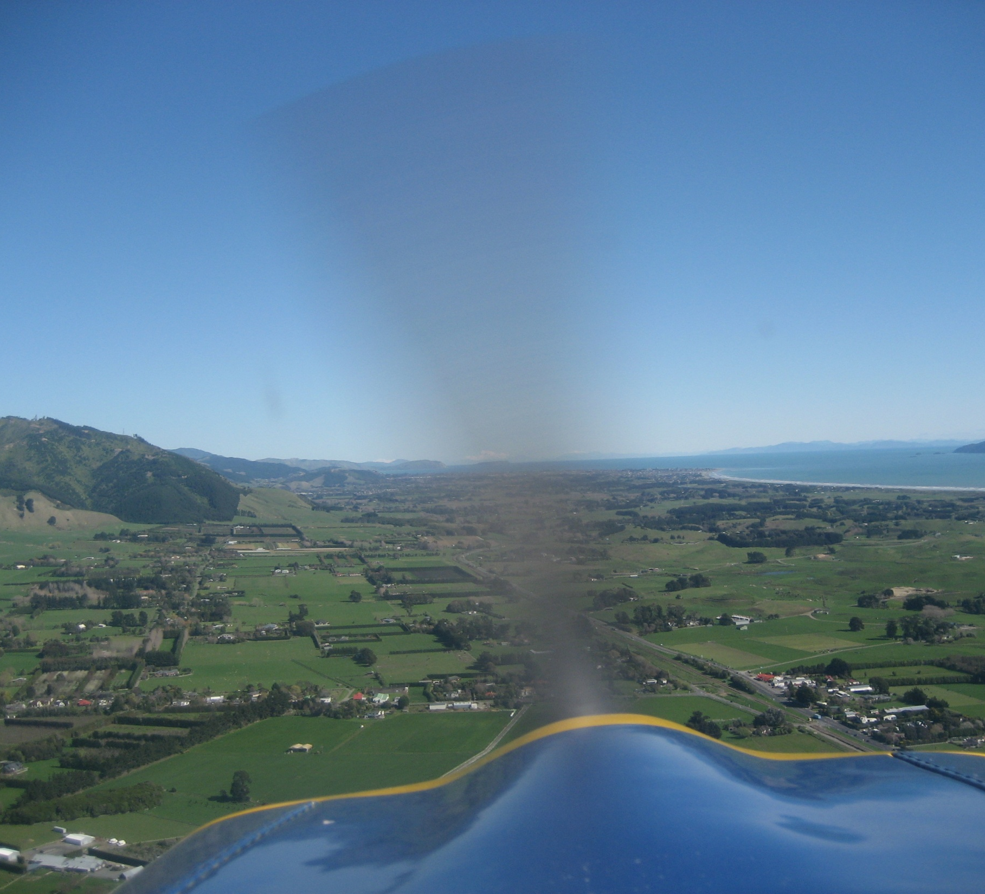
Cross Country Kapiti threats
Airspace – local & surrounding
MBZ calls
Wind
Micro climate weather
Aerodrome
AFIS
Traffic – IFR & VFR, local/transiting
Adjacent airfields
Navigational features
Alternate options

Slide 9

Mountain Flying
Horizon–close/far/high/low
Weather
Illusions–snow/sun/shadow/clarity
Gradient
Navigation
Valley flying
Saddle crossing
Traffic
Emergencies
Position-high/low/close/right/left
Communication
Reactive

Slide 10
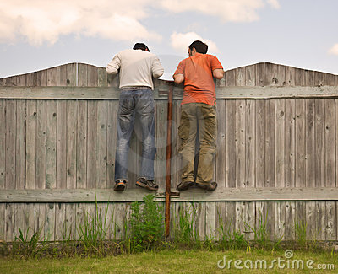

Whenever in an aircraft with blades turning consider:
Who can I harm? Who/what can harm me/my passengers/my aircraft?
Threat thought:
Anticipate threats

Slide 11
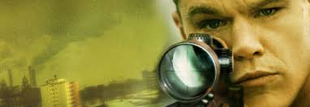
Be like Jason Bourne…
Process threats continuously…

Slide 12
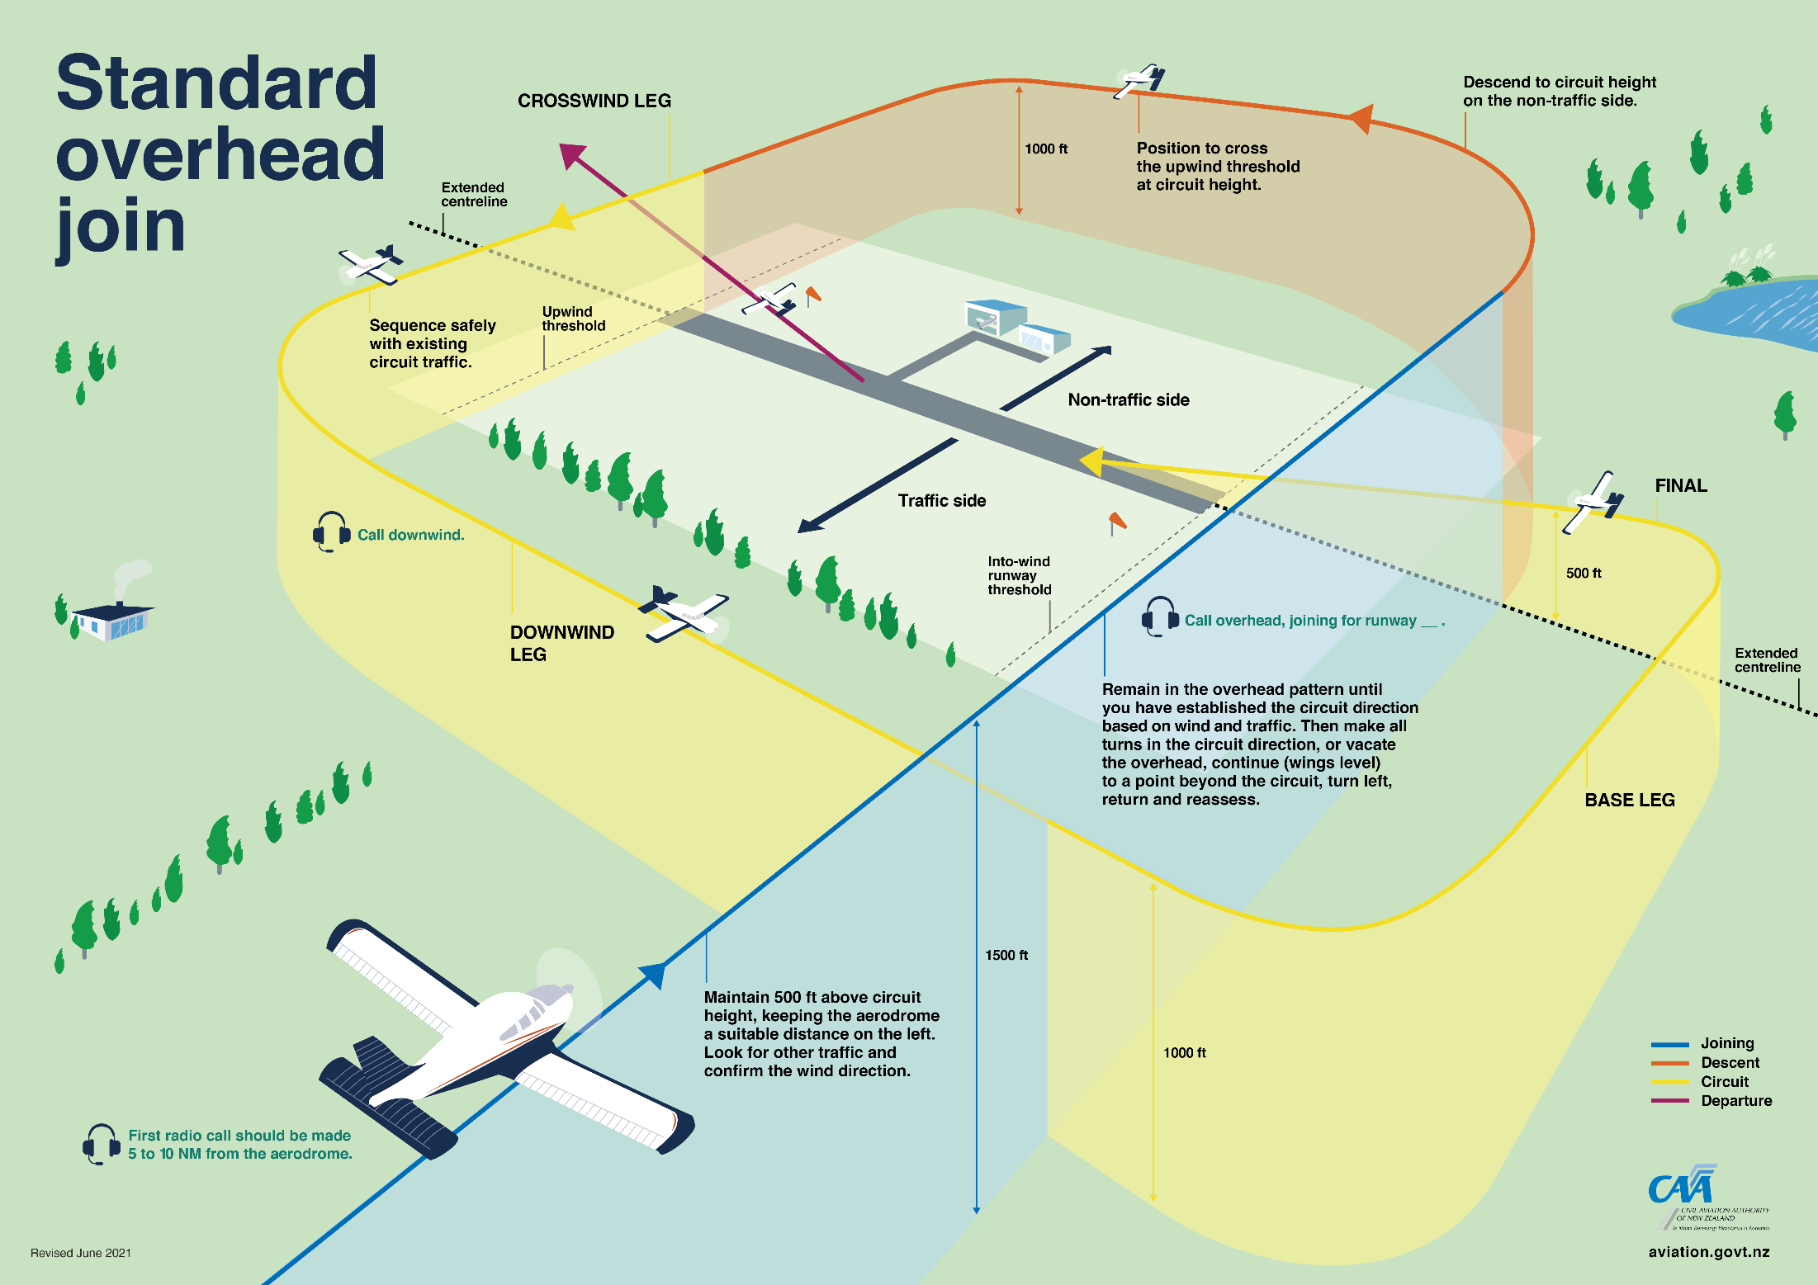
Joining and departing threats

