Slide 1



Teaching Visual Navigation Part 1
Flight Instructor Seminar 2022
Guy Brooking

Slide 2
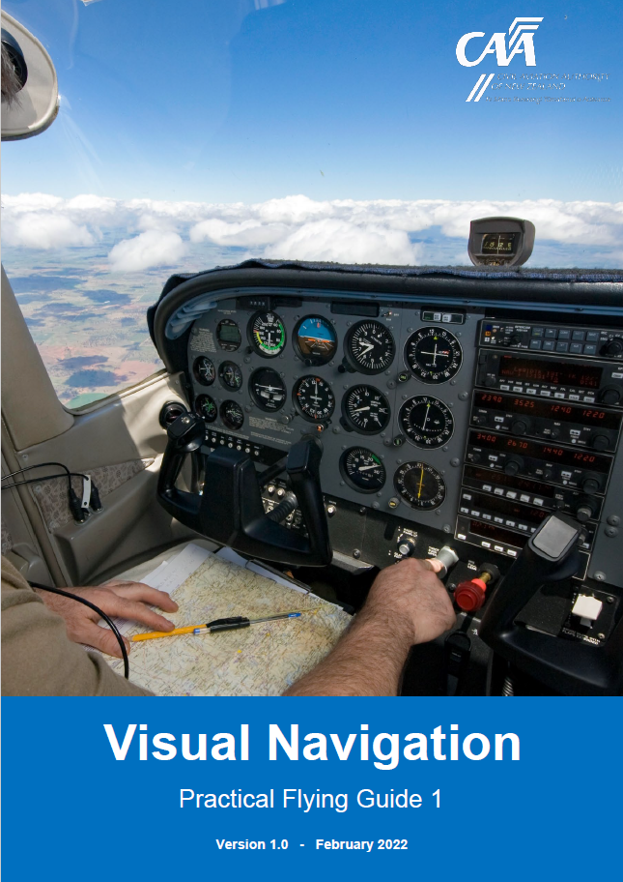
Introduction
Practical Flying Guide #1
Visual Navigation
FI Guide Navigation Section
https://www.aviation.govt.nz/licensing-and-certification/pilots/practical-flying-guides/
Notes:
Flight Training Safety Strategy
Not written as a training document
FI Guide on “Teaching Navigation”
We want to acknowledge that cross country is taught well in some places. But, where a school or club has no structured navigation training, or where there may be opportunity to improve, we want to provide this material as a suggested good practice.
This briefing will attempt to give a brief overview of ‘how to teach’ these Nav techniques.

Slide 3
Content
What is Visual Navigation?
Why Teaching Visual Navigation is Important?
How?
  Prior Learning
  Ground Course
  Structure of Airborne Lessons
  Lessons 1 – 4
  Solo Supervision
Notes:
First couple of slides will ‘touch on’ the ‘What and the Why’
Then most of the of the presentation will be the ‘How’

Slide 4
What is Visual Navigation?
Structured and time-based method
Using D.R. (Dead-reckoning)
Avoids the need to ‘feature crawl’, or follow progress with a finger on the map
Notes:
Not map reading - a component
It is a structured time-based method
Using dead reckoning techniques. Heading & time
Map reading is only one of the skills required to navigate
Why is this important?

Slide 5
Why Teaching Visual Nav’ is Important
The ‘tech’ might fail
Time-Based = Better workload management = More capacity
More time for LOOKOUT
Continual awareness of position TIME-MAP-GROUND
Teaches ‘estimation’ skills and ‘gross error checks’
Skills transfer to IFR and high-performance aircraft
Notes:
The tech fails. Distraction/Reliance
Teaches time-based methodology to a flying
Development of ‘routines’
Prioritisation according to the time-scale
Sequencing of tasks
Manage the workload
More capacity
Time for LOOKOUT
Time to think
Continual awareness of position using TIME-MAP-GROUND
Estimation – with practice, surprisingly accurate
Gross error checks – vital skill in all aspects of flying
Transfer into IFR flying and later on, commercial route flying.
Thinking in terms of time not distance
Faster aircraft
Positional awareness

Slide 6
Content
What is Visual Navigation?
Why Teaching Visual Navigation is Important?
How?
  Prior Learning
  Ground Course
  Structure of Airborne Lessons
  Lessons 1 – 4
  Solo Supervision
Notes:
We’ve discussed the ‘What and the Why’
Now I’ll focus on the ‘How’
Starting with Prior Learning

Slide 7
Prior Learning
Aircraft Handling
Map reading
Use of Radio
Aeronautical Publications
Weather Assessment
Threat and Error Management
Notes:
Straight and level and in trim
Consistently hold a heading and altitude
Climb or descend whilst maintaining a heading
Turn accurately onto heading
Map reading introduced on the student’s very first lesson.
Next lesson, how to check position. Identify airspace boundaries.
Climbing and descending lesson identify the vertical airspace boundaries.
Later, how to estimate a heading back to the airfield.
Simple, and drip-feed
Instructor modelling; carry a map, and refer to map
Pre-flight brief, bring out a map.
Debrief, bring out the map.

Slide 8
Content
What is Visual Navigation?
Why Teaching Visual Navigation is Important?
How?
  Prior Learning
  Ground Course
  Structure of Airborne Lessons
  Lessons 1 – 4
  Solo Supervision
Notes:
Students will have passed a Navigation exam
But will still need a briefing or series of briefings as to the practical application

Slide 9
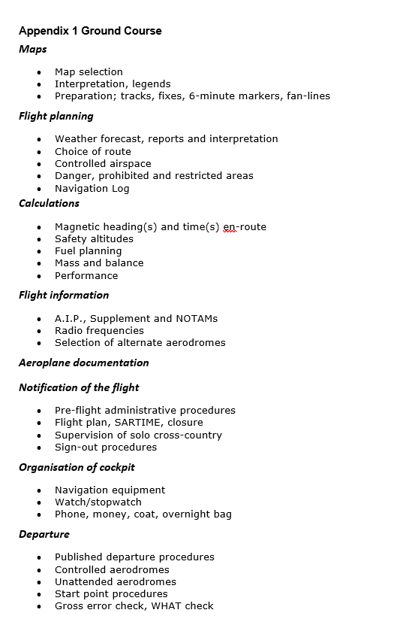

Ground Course
Notes:
Students could use the Visual Navigation guide as the reference text
In which case the FI Guide will support teaching those techniques
Sample ground course HANDOUT
All up, there’s probably a day or two of ground briefings to get through

Slide 10
Content
What is Visual Navigation?
Why Teaching Visual Navigation is Important?
How?
  Prior Learning
  Ground Course
  Structure of Airborne Lessons
  Lessons 1 – 4
  Solo Supervision
Notes:
With the foundations of prior learning and a ground course completed
We can now consider the structure of the airbourne lessons

Slide 11
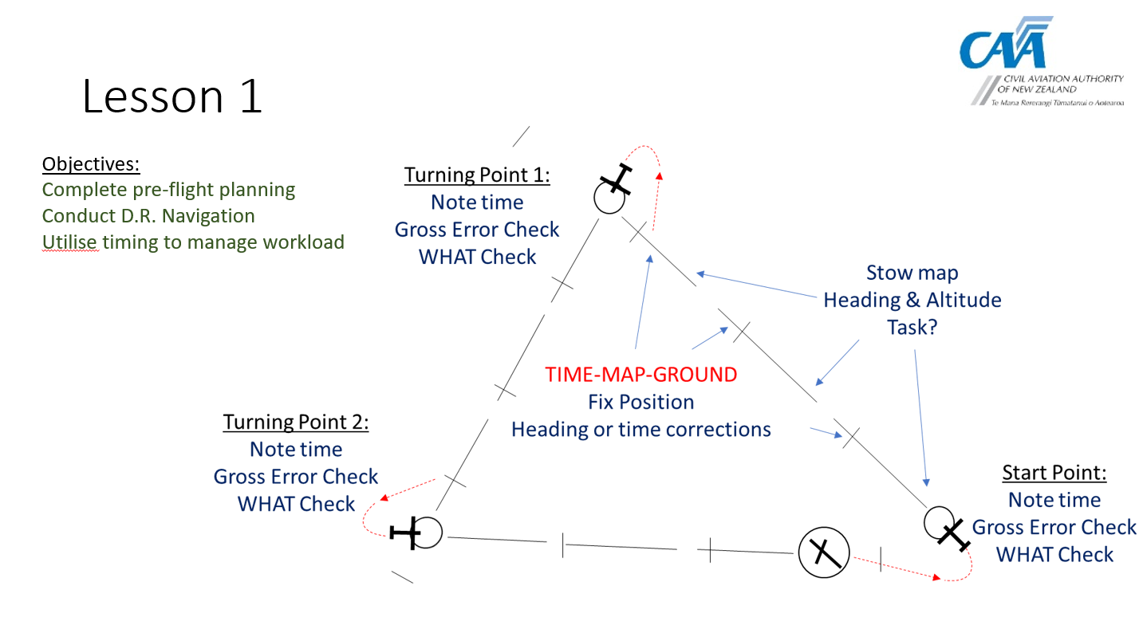
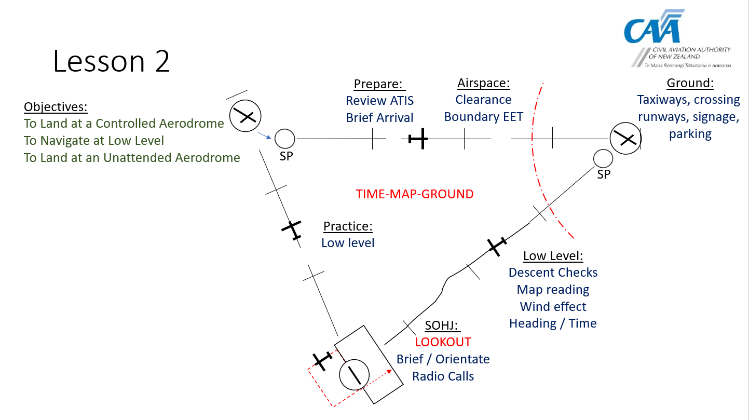
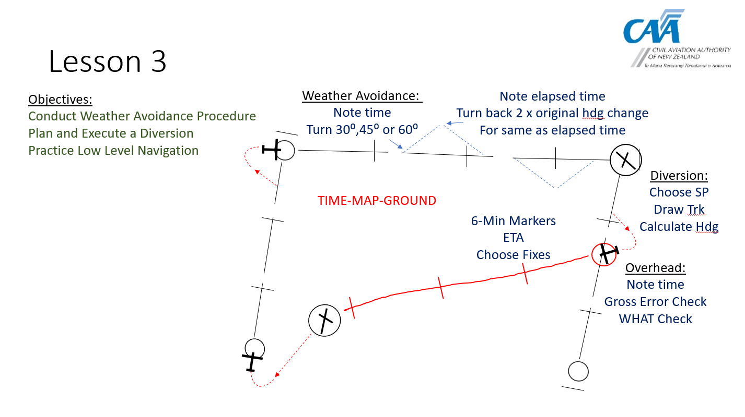
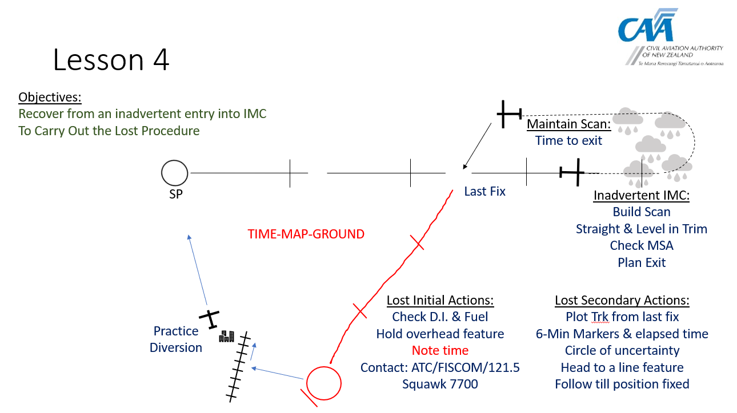
Lessons 1 - 4 Templates
Notes:
FI Guide TEMPLATES
These 4 lesson and board briefs provide a structure to teach the techniques
It doesn’t have to be 4 lessons, it could be 3, or it could 5
Triangular routes may not suit your location.
Controlled airfields may not be that close, requiring longer legs
Local terrain may present issues
All of these templates can be adapted to suit local conditions, whilst teaching the techniques
And the board briefing must represent the actual route you will fly
Let’s look at the AC requirements

Slide 12
Structure of Airborne Lessons
AC61-3
  Stage 1
    1 hr dual
    1hr solo
  Stage 2
    2hrs dual
    2hrs solo
  Stage 3
    2hrs dual (Cross-Country Demonstration of competence)
    2hrs solo
These are the Minimum Requirements
Notes:
AC61-3 provides a structure for the navigation phase of lessons.
3 stages
5hrs dual 5hrs solo
Some flexibility but solo must integrate logically with the dual ie;
Don’t do all the dual, then all of the solo
Minimum requirements
The FI Guide complements AC

Slide 13
Structure of Airborne Lessons
AC61-3
  Stage 1
    1 hr dual
    1hr solo
  Stage 2
    2hrs dual
    2hrs solo
  Stage 3
    2hrs dual (Cross-Country Demonstration of competence)
    2hrs solo
These are the Minimum Requirements
  FI Guide Navigation Section
  Lesson 1 – D.R. Navigation
  1st solo cross country
  Lesson 2 – Landing Away
  2nd solo cross country
  Lesson 3 – Wx Avoidance & Diversion
  Lesson 4 – Inadvertent IMC & Lost Procedure
  3rd solo cross country
Notes:
The 4 lesson templates complement the AC
Remember the number of lessons can be changed
These are just convenient examples
You’ll also note that we have added the RECOVERY FROM INADVERTENT IMC procedure

Slide 14
Structure of Airborne Lessons
AC61-3
  Stage 1
      Preparation of charts and in-flight log, weather evaluation, NOTAM’s, fuel and oil requirements, fuel management, maintenance of heading and map reading.
  Stage 2
      To include at least one landing at a controlled aerodrome (which may be deferred to stage III if operationally appropriate) and one landing at a non-controlled aerodrome at least 25 nm from the point of departure.
  Stage 3
      Dual instruction including a diversion requiring low-level navigation (incorporating terrain awareness principles) with at least one landing en route. At least 1 solo cross-country flight is to be made into controlled airspace in an aircraft equipped with a functioning two-way radio
  FI Guide Navigation Section
    Lesson 1 – D.R. Navigation
      Complete pre-flight planning
      Conduct D.R. Navigation
      Utilise timing to manage workload
    Lesson 2 – Landing Away
      To Land at a Controlled Aerodrome
      To Navigate at Low Level
      To Land at an Unattended Aerodrome
    Lesson 3 – Wx Avoidance & Diversion
      Conduct Weather Avoidance Procedure
      Plan and Execute a Diversion
      Practice Low Level Navigation
    Lesson 4 – Inadvertent IMC & Lost Procedure
      Recover from an inadvertent entry into IMC
      To Carry Out the Lost Procedure
Notes:
If you put the lesson content next to the AC requirements, they are aligned

Slide 15
Lessons 1 - 4 Templates
Notes:
This morning we have covered all of the preparation up to the airbourne exercises
This afternoon we will look closely at the Instructional Techniques for teaching navigation

Slide 16
Questions?

