Slide 1
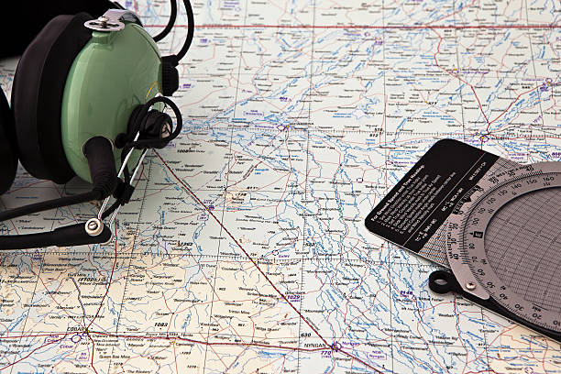


Teaching Visual Navigation Part 2
Flight Instructor Seminar 2022
Guy Brooking

Slide 2
Content
What is Visual Navigation?
Why Teaching Visual Navigation is Important?
How?
  Prior Learning
  Ground Course
  Structure of Airborne Lessons
  Lessons 1 – 4
  Solo Supervision
Notes:
We’ve covered the ‘What and the Why’
Also, under the ‘How” we’ve discussed prior learning, the ground course and the lesson structure
Now we’re going to look at the lessons themselves
But before that, any QUESTIONS from this morning’s session?

Slide 3
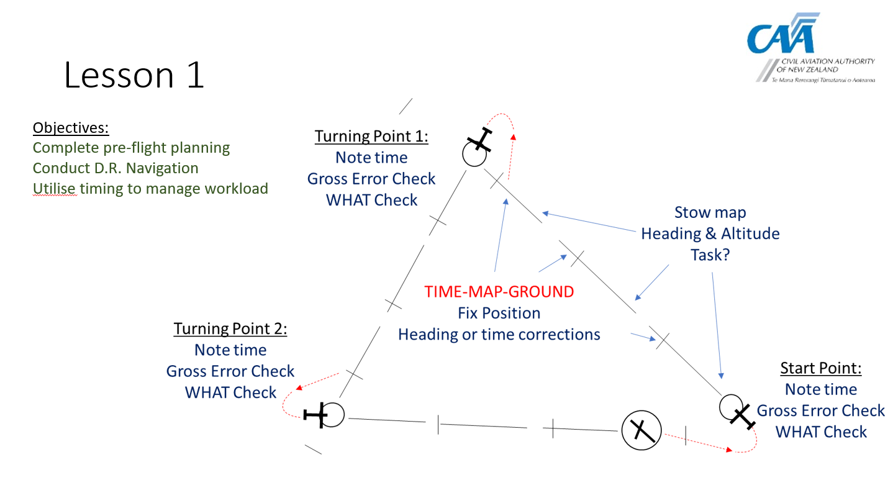
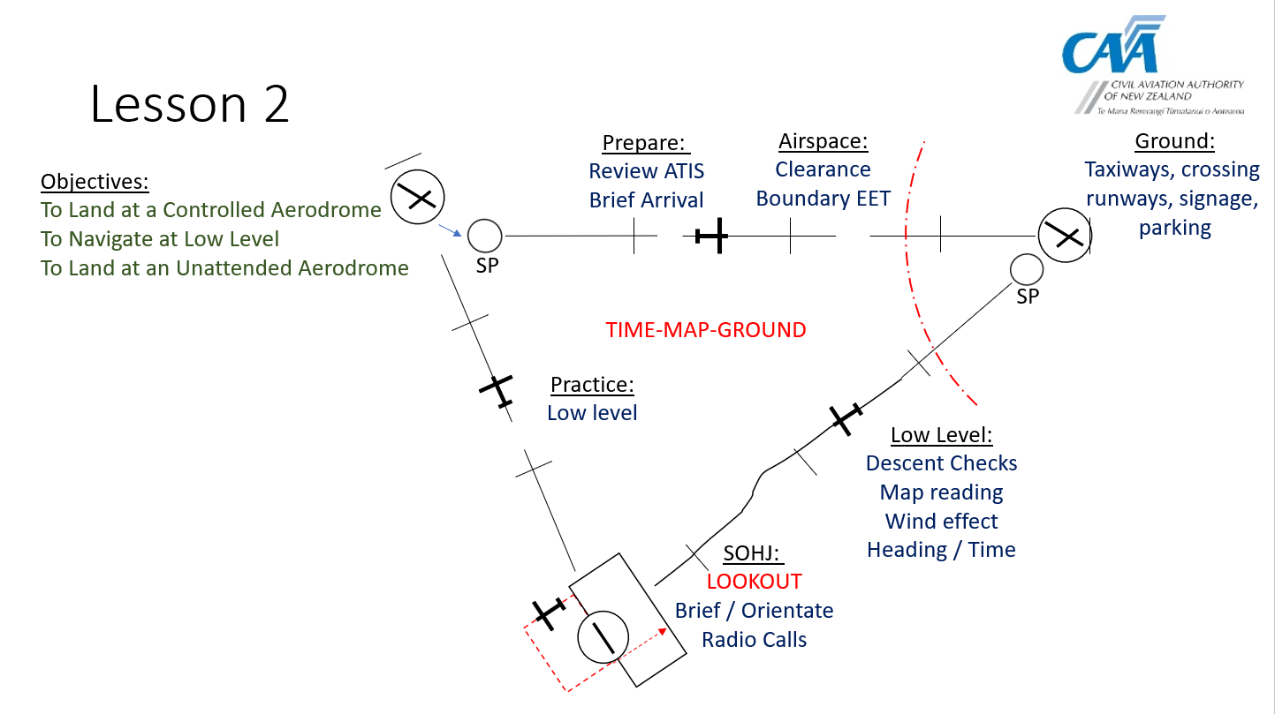
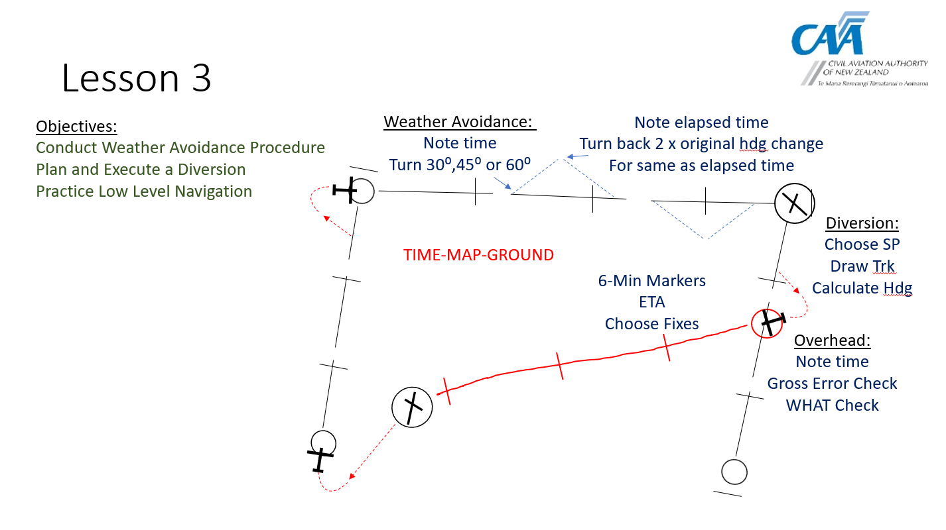
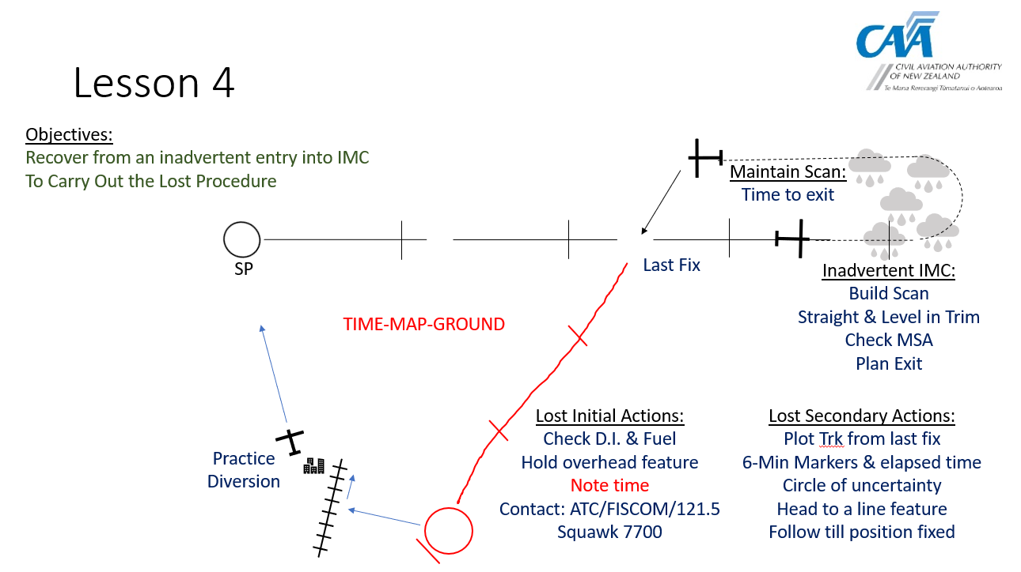
Lessons 1 - 4 Templates
Notes:
As a reminder these are the 4 lesson TEMPLATES
Approximately triangular flights, with roughly 20mins legs.
They may need to be adjusted to suit the local environment of terrain and airspace.
Before flying, there needs to be some planning and preperation

Slide 4
Planning and Preparation
Initial planning
  Route given in advance
  Instructor determines the route
  Student plans:
    Map is prepared
    A Navigation Log has been started
    Frequencies noted down
    Student to “armchair fly” the route
Notes:
Planning and preparation can be broken down into INITIAL planning and planning ON THE DAY
For the initial planning, the route should be given a few days in advance
The route must be set by the instructor or flight school to ensure the objectives of the lesson will be met
The student should prepare and mark up the the map
Begin putting together a Navigation Log, with tracks and distances etc, and frequencies
And then ‘armchair’ fly the route

Slide 5
Planning and Preparation
On the day
  Student completes planning
  With instructor’s help
  Allow time
    Winds applied to Navigation Log
    NOTAMs and weather checked
  Whiteboard briefing
Notes:
On the day the student completes planning
With the instructor’s help
This takes time
Then the briefing
Now we’re ready to go flying

Slide 6

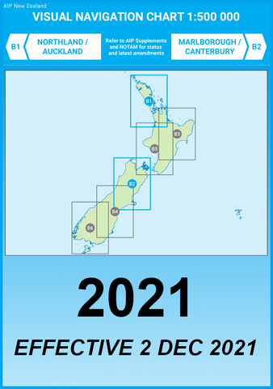
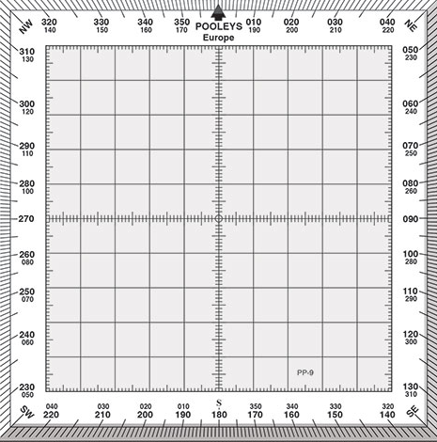
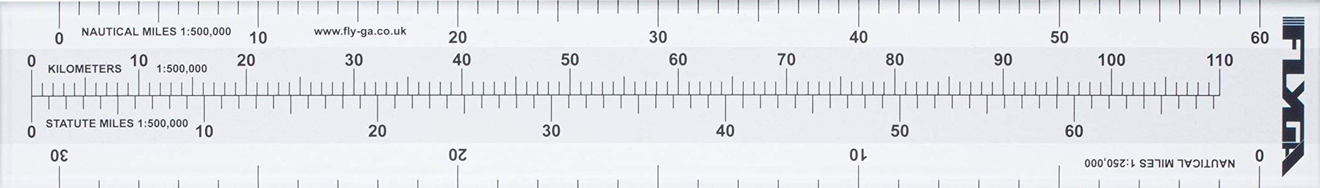
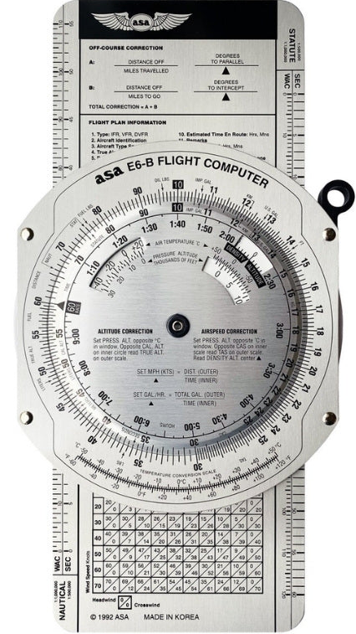
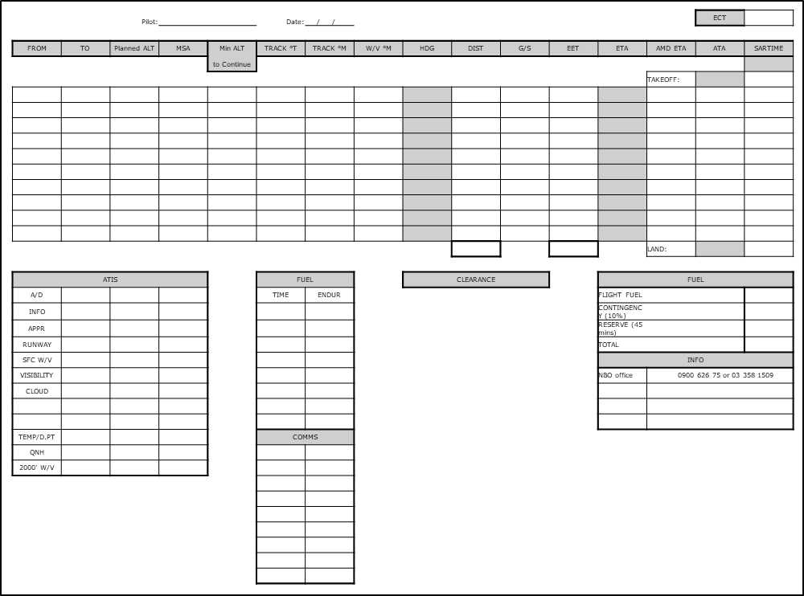

In-flight Equipment
Notes:
During the planning the student will have used navigation equipment, and will also need equipment in the air.
But we don’t need to use all of it in the air. The simple techniques explained in the nav guide mean we only need a map, a pen, the nav log and a watch or timepiece.

Slide 7
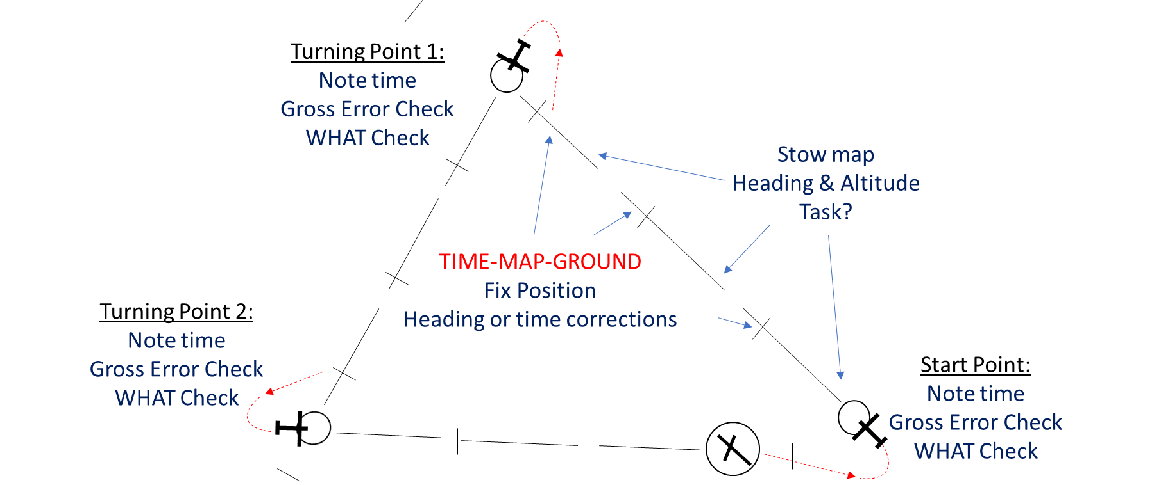
Lesson 1
Objectives:
Complete pre-flight planning
Conduct D.R. Navigation
Utilise timing to manage workload
Notes:
Students can easily become over-loaded
We’ll discuss instructional techniques to avoid this
Students and instructors engrossed in map reading
These techniques prevent that from happening
Board brief layout:
Considerations, airmanship, aircraft management, human factors omitted in this presentation
Airport, SP, TPs fixes, 6 min markers, 20 min legs.
Leg 1, 2 & 3.
In this lesson, the 1st leg is taught, the 2nd leg is a practice with guidance, and the 3rd leg should be practice. Let’s break it down a bit more:
Student take off and initial departure.
FI takes over prior to SP
Once established, map is stowed
Note time at first fix
Hand control to student
Take control 2 mins prior to fix, bring out the map and teach TIME-MAP-GROUND
Errors are ideal, but do not induce
Teach correction of track and time errors
Note time at second fix, stow map
Hand control back to student
While student flies, all they should do is maintain height and heading, lookout, and any planned tasks such as a cruise check or radio call
Take control 2 mins prior to second fix, bring out the map and repeat TIME-MAP-GROUND
Correct any errors and stow map
Hand control to student
2 mins prior to TP take control and teach TP
Once established, stow map, hand control back to student
2nd leg student practices navigating. You take control at fixes, so they can concentrate on nav techniques
Third leg, student ideally navigates and flys by themselves
If unable, then further dual before 1st cross country.

Slide 8

Lesson 2
Objectives:
To Land at a Controlled Aerodrome
To Navigate at Low Level
To Land at an Unattended Aerodrome
Prepare:
Review ATIS
Brief Arrival
Airspace:
Clearance
Boundary EET
Ground:
Taxiways, crossing
runways, signage,
parking
SP
TIME-MAP-GROUND
SP
Practice:
Low level
Low Level:
Descent Checks
Map reading
Wind effect
Heading / Time
SOHJ:
LOOKOUT
Brief / Orientate
Radio Calls
Notes:
Explain layout of brief; Airfileds, SP, TPs fixes, 6 min markers.
After completion of the 1st solo cross-country, Lesson 2 looks at landing away, controlled and unattended aerodromes, and low-level navigation
Again, FI sets route a few days before flight and then assists completion of planning. Briefing to mirror the route to be flown.
The first leg is a practice for the student, of the techniques taught in lesson 1.
Tasks to ‘schedule in’ using the time scale are; collecting an ATIS, briefing an arrival and obtaining a clearance.
Time-scale for airspace boundary. TIME-MAP-GROUND
On the ground, techniques for being at an unfamiliar airfield can be taught.
Taxi route (already planned in pre-flight prep), signage, crossing of runways.
During the second leg the FI takes over to teach low level navigation.
Important; descent checks, hold map UP, wind, poor vis config.
Keeping track of overall heading and time
Again, use the time-scale to manage tasks approaching the airfield, keep control while the student get’s organised, makes a radio call and briefs the join.
Then give them control to practice a SOHJ and landing.
On the final leg, the student can practice low level navigation

Slide 9
Lesson 3
Objectives:
Conduct Weather Avoidance Procedure
Plan and Execute a Diversion
Practice Low Level Navigation
Weather Avoidance:
Note time
Turn 30⁰,45⁰ or 60⁰
Note elapsed time
Turn back 2 x original hdg change
For same as elapsed time
Diversion:
Choose SP
Draw Trk
Calculate Hdg
TIME-MAP-GROUND
6-Min Markers
ETA
Choose Fixes
Overhead:
Note time
Gross Error Check
WHAT Check
Notes:
Explain layout of brief; Airfields, SP, TPs fixes, 6 min markers.
Lesson 3 teaches weather avoidance and diversion procedures. 1st leg is a pure practice, with little instruction.
2nd leg take control, teach wx avoid – simulated or real wx
Hand back control for student practice
3rd leg take control to teach diversion
Select diversion point and SP – circle
Hand draw track line
Estimate track T, then convert to M
Add wind = heading
GS/10 = 6min – add
Count of time for eta
Choose fixes
At SP turn onto new heading
Note time
Gross error check
WHAT check
Calculate MSA + Fuel
Hand back control

Slide 10


Lesson 4
Objectives:
Recover from an inadvertent entry into IMC
To Carry Out the Lost Procedure
Maintain Scan:
Time to exit
SP
Last Fix
Inadvertent IMC:
Build Scan
Straight & Level in Trim
Check MSA
Plan Exit
TIME-MAP-GROUND
Lost Initial Actions:
Check D.I. & Fuel
Hold overhead feature
Note time
Contact: ATC/FISCOM/121.5
Squawk 7700
Lost Secondary Actions:
Plot Trk from last fix
6-Min Markers & elapsed time
Circle of uncertainty
Head to a line feature
Follow till position fixed
Practice
Diversion
Notes:
Recognising inadvertent IMC. Unable to maintain attitude by visual means. Unable to establish position by visual reference due features being obscured by cloud.
Treat as a genuine emergency
Note a feature and the time O/H
Maintain a new heading with student under the hood
Take control and teach the ‘lost procedure’
Never ‘wander’ – either hold heading, or hold position (note time)
Initial actions
Get help
Secondary actions
Plot track
6 min markers
Circle of uncertainty
Turn toward a line feature
Hand control back
Finally, the student practice a diversion back to the home airfield.

Slide 11
Content
What is Visual Navigation?
Why Teaching Visual Navigation is Important?
How?
  Prior Learning
  Ground Course
  Structure of Airborne Lessons
  Lessons 1 – 4
  Solo Supervision
Notes:
Final point I wish to discuss is solo supervision.

Slide 12
Solo Cross-Country
Solo integrated with Dual (not all dual, then all solo)
Solo only after dual objectives met
Solo routes determined by instructor
Solo routes chosen to be suitable for level of competence
Weather and fuel must have ‘healthy margins’
Student carry phone, money, overnight bag…
Do not express frustration at a ‘turn-back’ or decision not to fly due to weather
Debrief the student at completion of flight

Slide 13
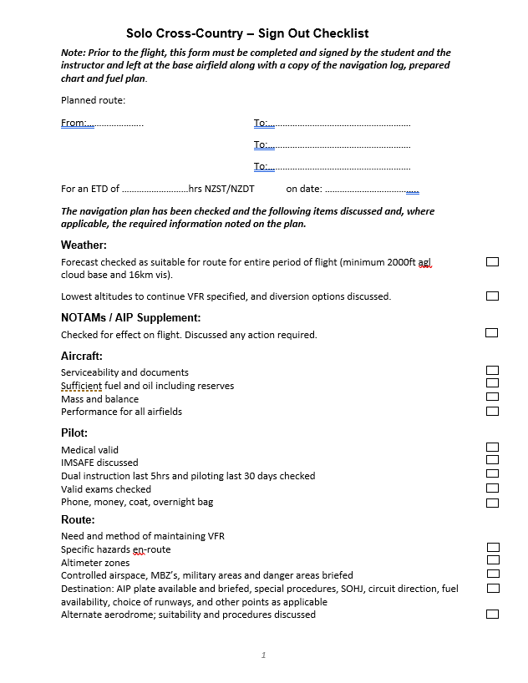
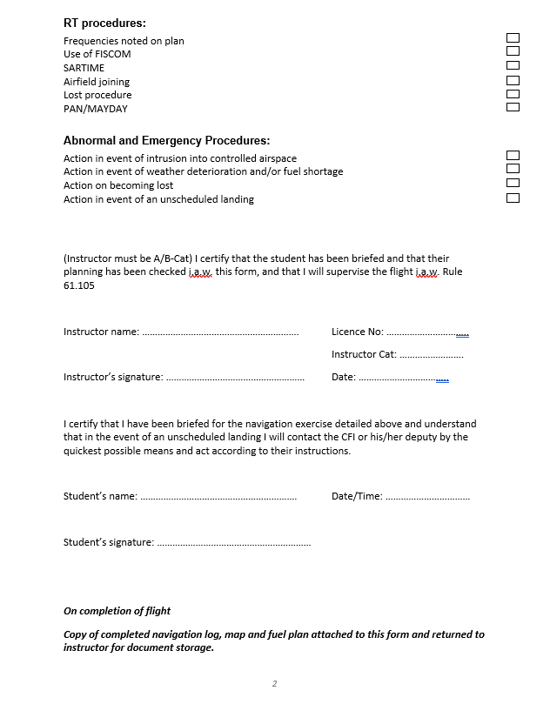
Solo Supervision
Notes:
Solo cross-country flights are an area of risk and need to be carefully managed and supervised to mitigate that risk.
Both the flight school and the instructor are responsible for ensuring safe and effective supervision. There is a lot to consider before sending a student on a solo cross-country flight, and therefore having a checklist is a very good idea. Here is an example, which can be modified to suit. Many flight schools already have some kind of ‘Signing Out’ process like this, as part of managing their risk under SMS.
Monitor student’s progress of tracking devices like V2Track or Spidertracks etc

Slide 14
Questions?

