Slide 1
Instructor Seminar
The Aging Pilot
October 2022

Slide 2
Why speak about the aging pilot
Pilots population is getting older
Instructors are getting older
Instructors teach and assess old pilots
Need to understand the effects of aging on pilots ability
Need to have insight in one’s own aging

Slide 3
Cause for increase pilots population getting older
Aging of population - people live longer
In NZ, no age limit for CAA medical certification
ICAO standards now accepting ATPL until age 65 -> considering age 67
Growth in air traffic, thus increased demand for more pilots, hopefully experienced pilots.

Slide 4
Age pyramid for pilots in the USA

Slide 5
Average Age of Pilots USA

Slide 6
John M Miller died in June 2008 aged 102, Still flying at age 101

Slide 7
Some Thoughts about aging …
• I’m slowing down
• I keep gaining weight as I get older
• I’m not as strong as I used to be
• My memory isn’t good anymore
• My body is aching
•I’m getting too old for this… NOT AT ALL! Much Denial !
Critical role of instructors

Slide 8
Changes
Vision
Hearing
Strength and range of movements
Posture and balance
Sleep regulation
Thermoregulation
Mental function

Slide 9
Changes
Vision
Hearing
Strength and range of movements
Posture and balance
Sleep regulation
Thermoregulation
Mental function
Brain works differently
Learns differently
Brain declining function

Slide 10
Vision
Decrease in
Visual acuity
Decrease in dynamic visual acuity
Worse in low illumination
Contrast sensitivity
Dark adaptation
Visual fields

Slide 11
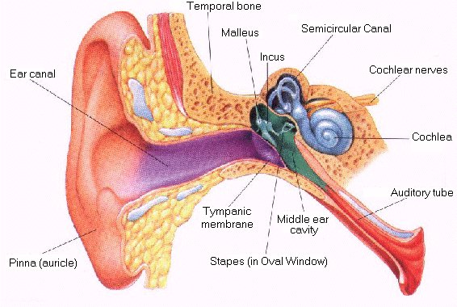
Hearing
Unable to hear higher frequencies – Presbycusis and noise induced hearing loss (NIHL)
Difficult to pick out voice or sound in a noisy environment
Can affect how verbal instructions are heard
In flight hearing test protocol available (forms for certification)

Slide 12
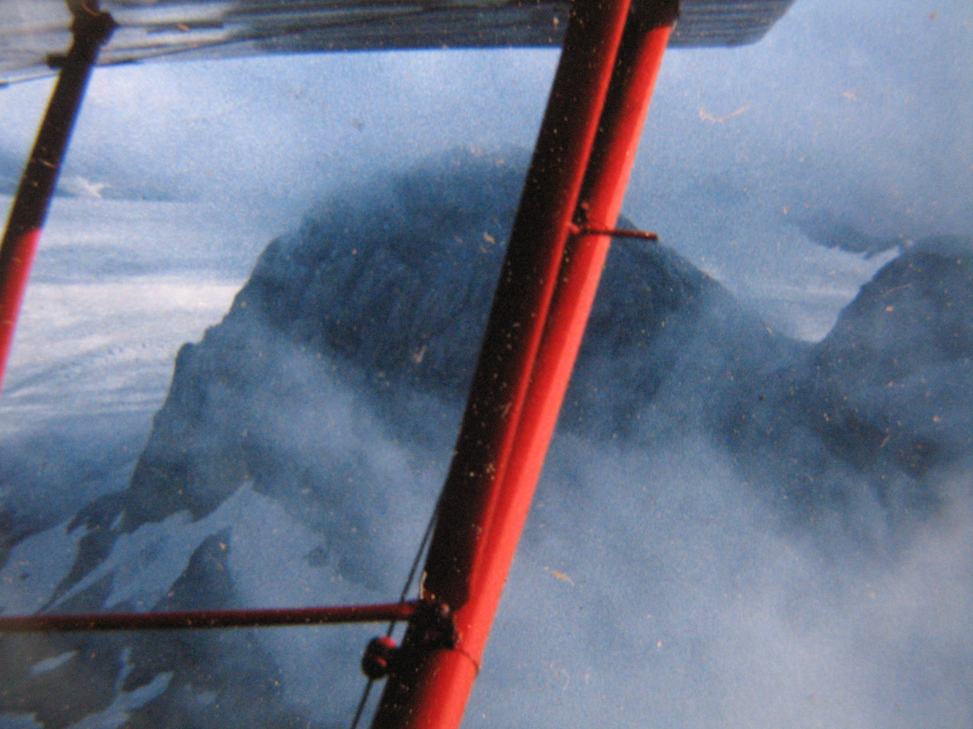
Age and Hearing

Slide 13
Strength and Motion
Lose about 15 to 20 % of strength
Older workers (pilots) can do the same tasks but they may be working closer to their maximum
Hydraulics failure ?
Loss of flexibility such as reduced, shoulders, neck motion.
Overhead controls ?
Lookout ?

Slide 14
Posture and Balance
More difficult to maintain good posture and balance
Cockpit comfort and general ergonomics ?
Can reach manual gear extension lever ?
Passenger assistance needed ?

Slide 15
Sleep Regulation
Affects both length and quality
Body aches
Night wee !

Slide 16
Sleep Regulation
Solutions:
Awareness of issue & effects of fatigue
More time between extended shifts
Cockpit should not be too warm.
Keep tasks interesting

Slide 17
Cognition
Memory:
Working memory and memory span declines
Retrieval of information from memory may be slower
Less likely to remember instructions unless using memory aid
Procedural memory largely unaffected (crystallised memory)
More time to learn & acquire new skills.
Currency is important !

Slide 18
Cognition
Fluid intelligence
Selective attention
Dual task capability
Information processing
Reaction time
“Crystallised” intelligence, verbal tasks
and vocabulary remain

Slide 19
Cognition
Learn differently
Based on what they already know
Past experience with training and education
Need to understand to learn
Some studies report that they may learn
slower but show no difference in performance/accuracy once material is learned

Slide 20
Cognition
Case study:
Age mid 50
Intelligent and good mental function – Uni graduate in science – Very skilled, motorbike licence
Instructor speaks very fast
Instructor tells student off for omissions rather than explains “I have told you before”
Student completely lost confidence within 3 lessons
Student stopped flying for over a year but eventually returned, good experience and loves it.

Slide 21
Evidence for Age Related Pilot Performance Decrement
No good accident data to support age limit, but accident rate probably increases after age 60
Sudden incapacitation remains unlikely and is mitigated by presence of co-pilot
Relationship between age, cognitive function and pilot performance not so clear
Delay in detecting failures

Slide 22
How safe are old pilot - Golaszewski (1) https://skybrary.aero/sites/default/files/bookshelf/3838.pdf
Incidents / accidents Rates inversely proportional to recent flight time.
Pilots with low amounts of recent flight time:
Older pilots have more accidents than younger pilots
Older pilots are less likely to have an accident than younger pilots if they have high amounts of recent flight time.
When recent flight time is low professional pilots have more accidents than private pilots.
Independent of total flight time private pilots have more accidents.

Slide 23
Golaszewski (2)
In private pilots the risk of accidents declines until age 60 when accidents become more likely
Pilots with more than a 1,000 hours total time and less than 50 hours recently have most accidents,
Pilots with over 1,000 hours total time and more than 50 hours recently have the fewest accidents.

Slide 24
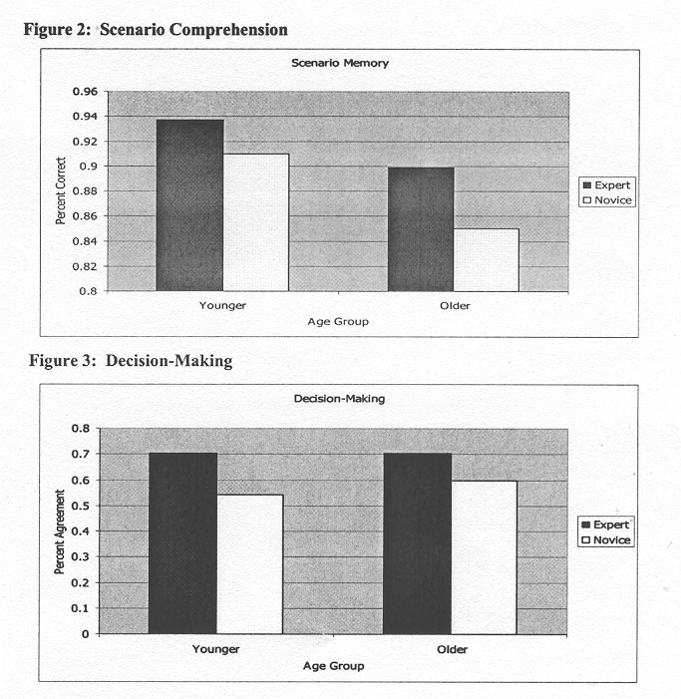
Morrow

Slide 25
Aerospace Medical Association
August 2004
“On viewing the existing evidence, the AMA concludes there is insufficient medical evidence to support restriction of pilot certification based on age alone”.
Current International Regulatory Situation:
Age limit is now 65 under ICAO

Slide 26
Summary or possible problems
Problem | Check For
Strength & Mobility | Ability to operate controls etc during an emergency – Hydraulic failure Ability to maintain a good lookout
Vision | Able to read instruments and charts and observe objects in conditions of glare or reduced contrast sensitivity. Carries and uses spectacles if necessary
Hearing | Able to hear your instructions and accurately interpret ATC and communications from other aircraft
Cognition | Ability to multi-task, cope with emergencies and problem solve whilst performing pilot duties

Slide 27
What Can You Do as the Flying Instructor?
Look for Problems with:
General Mobility
Strength
Vision
Hearing
Cognition
Adapt teaching technique
Seek advice from experienced colleague

Slide 28
BFR or currency training / type rating Check experience and recent experience
BFR / check flight / type rating showing good skills, commensurate with experience and currency
Instructor input result in better skills
☺
BFR / check flight type rating not showing good skills
Currency issue ? Pilot quickly regain skills
☺
Cognitive issue ? Pilot slow to recover skills, ongoing deficiencies
Safe enough ? 🚩

Slide 29
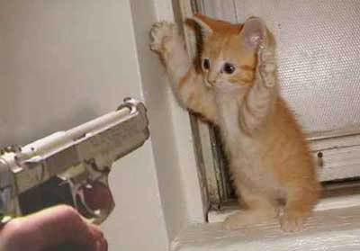
The Last Resort

Slide 30
Reminder of Obligations

Slide 32
Personal Strategies & Advice to pilots
Age well and wisely
Exercise
Sleep hygiene
Eating well
Limit alcohol
Know yourself and your health
Remain current !
Beware of delusions of adequacy

Slide 33
Dietary Factors
Starvation vs. Overweight
Anti-oxidants
Japanese and Mediterranean diets
Unsaturated fats
Salt
Specific disease factors
Alcohol

Slide 34
Surveillance Reports to CAA
Reports required from Flight instructor / CFI or Chief pilot
Pilots with conditions under surveillance
History of drug or problematic alcohol use;
History of mental illness, i.e., Depression
Learning difficulties,
Attention deficient syndrome, Obsessive compulsive.
Instructor does not know the condition but what we need:
Comments on progress, learning issue, writing issue, Speech issue,
Obsessive behaviour,
Behaviour etc.
Physical issues, hearing , vision etc.

Slide 35
Where is this ?
Clue:
Swiss cheese

Slide 36
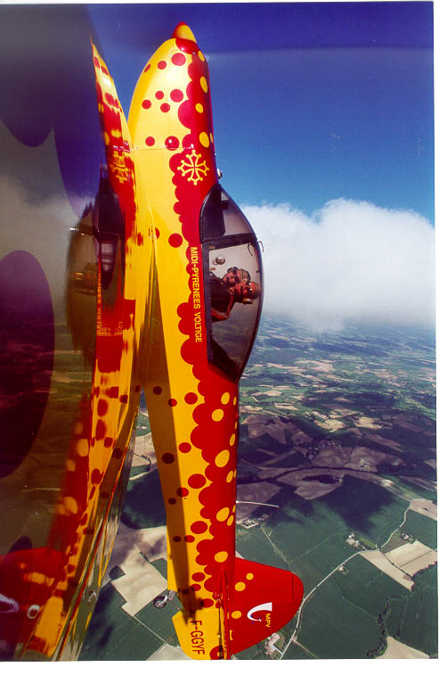
Questions ?
Golaszewski
https://skybrary.aero/sites/default/files/bookshelf/3838.pdf
CAP 10 – Avions Mudry

