Slide 1
Flight Examination Feedback
CAA Flight Instructors Seminar 2022
October 2021

Slide 2
Administration Issues
We still have an ongoing issue of scheduling and booking flight tests. EVERYTHING MUST be booked via Lorraine Palmer. PLEASE DO NOT contact flight examiners directly to check their availability.
All big changes (delays etc.) to flight tests dates need to go via Lorraine.
300nm navigation for CPL done over two days, but only day 1 has all the landings. The second day is a straight return to base but using the time on both days for the 20-hour CPL Nav requirement.
Page 2
Notes:
Lorraine made the comment that flying schools ask the flight examiner if they are available before booking the flight test with Lorraine. The problem is sometimes the examiner thinks they are available because when Lorraine might already be planning to use them on the requested day.
Lorraine has the big picture and often they will not be available on her plan. Its important Aspeq can manage which examiners are in each place testing to avoid double-ups and costs.

Slide 3
CPL Flight Test Statistics
2021 - 384 candidates
35 % failed first time
Increasing over the years 2017 22%
Can we do better….
Page 3

Slide 4
IR Flight Test Statistics
2021 - 244 candidates
22 % failed first time
Increasing over the years 2017 11%
Can we do better….
Page 4

Slide 5
C-Cat / B-Cat Flight Test Statistics
2021 - 89 C – Cat candidates
12 % failed first time
Staying about the same over the years 2017 10%
2020 - 50 B – Cat candidates
12 % failed first time
Staying about the same over the years 2017 11%
Can we do better….
Page 5

Slide 6
How can we do better….
Page 6

Slide 7
What if everyone passed first time…
In 2017 we did 75 more tests than we needed to.
In 2022 we did 222 more test than we needed to.
How can we do better….
Page 7

Slide 8
CPL Flight – Common Failures
Groundwork – Pre-Flight Knowledge………………… Practical application of both
TEM ………………………………………………………Practical application and relevance
LOOKOUT…………………………………………………………. In-between exercise
Page 8
Notes:
What does the alternator do?
Understanding NOTAMs, knowing about them, what it means and effect it will have.
Lack of AIP knowledge. AIRAC cycle, amendments up to date, where phone numbers are.
Understanding of aircraft maintenance requirements. Ask if there is anything they observed on preflight or issues known about.
KDRs a lot of the time points are missing.
Weather. Met minimas practical applications. Incorrect wind component for Pcharts
Not able to nominate airspeeds for operation.
Knowing where other traffic is inflight.
Talking over radio calls, not listening to them.
Pre-take off briefing becoming very long winded.
Not referring to map during flight (not carrying a map)
Wasting time setting up exercises.
Tendency is to lookout before demonstrated turns or HASELL checks, but much less normal flight.
High wing aircraft, lifting the wing to clear the area before turning.

Slide 9
CPL Flight – Common Failures
Stalling – poor understanding …………………………..Not making it real
Max Rate Turns ……………………………We’ve lost the purpose of what they are for
Slow Flight / Low Flying ………………………………… Flying skill / Execution poor
Circuits ………………………………………………….. Poor technique
Page 9
Notes:
Stalling why are we learning this. Candidates still not that competent in stalling at the CPL level.
Use of aileron during the recovery.
Keeping straight of the reference point.
Difficulty in setting up and achieving a wing drop stall.
Not nominating a minimum altitude to have recovered by. Height – 3500’recovered by 2500’ .
Stall warning often ignored, only of for intentional stalls and max rate turns.
Making no reference to Va prior to commencing a Max rate turn.
Reference points, reference altitudes rituals taking far to long to find.
Slow flight Accuracy. Candidates struggle to co-ordinate pitch attitude and power, with no flap.
Coastal reversal turns, drifting to far away and not initially rolling into 45 AOB then reducing.
Circuits normal done at the end of the fight test, tired but still expected to perform to the same level of standard and therefore trained to perform for the whole flight test.
Circuit work with allowance for different conditions.
Able to confidently land on touchdown point and maintain runway centreline.
Flying big circuits when the don’t need to.

Slide 10
Instrument Rating – Common Failures
Groundwork – Pre-flight Knowledge …………. Practical not resisting rules
Route is rote learnt ………………………………..………………….. No resilience
Approach…………………………………. Monitoring and assessing performance
Visual Circling ……………………………………………. Practical application
Page 10
Notes:
Poor understanding of the practical rules.
Missing the GNSS/PBN ground course logbook certification sign off.
Not understanding or clarifying clearances.
Routes are generally learnt to rote. Something changes it can baffle the candidate.
Multi crew procedures to two pilot instrument rating should be operating to a SOP for multi crew flight.
Students have a reflex action to pull the gear up with engine failure. Assess conditions.
Not getting to MDA +50’ not taught an appropriate power + attitude to set at MDA.
Mental arithmetic, calculating wind, planning reasonably descent, miles of arc etc.
Managing descent. Nose is lowered before power is reduced, resulting in higher airspeed/groundspeed and then difficulty in descending in the time available.
Considering the missed approach with regards to fuel state. e.g I have two hours of fuel left, I will fly two approaches, if unable to land I will proceed to my alternate.
Circling approaches – Understanding the circling radius and descending once established on normal profile.

Slide 11
In General
Everyone is an ok job at each exercise focusing on what they think might be in the test…………………………
but not so good at the context of
“how we operate an aircraft”
Page 11

Slide 12
Yes…… we can do better…
What is the desired outcome from teaching slow flight?
To control the aircraft at 1.2 vs in various configuration whilst
Maintaining straight and level +/- 50 feet
Turning +/- 50 feet
Re-establishing normal cruise
But what is the reason for learning slow flight?
Page 12
Notes:
Try and get discussion here from the group and move it away from
Its in the test of +- 50 feet etc
Confidence in flying close to the stall
Go-around
Bounced landing

Slide 13
Teach by asking a different question…
What must the pilot be able to do in the low flying area?
Context
When would a pilot need the skills of low flying and how does it relate to other required flying skills
Same question different outcome?
Page 13
Notes:
Try and get discussion here from the group and move it away from
Its in the test of +- 50 feet etc

Slide 14
Teach by asking a different question…
What must the pilot be able to do for a stall demo?
Context
When would a pilot need the situational awareness to recognise and the skill to recover the aircraft from a stall.
Same question different outcome?
Page 14
Notes:
Try and get discussion here from the group and move it away from
Its in the test of +- 50 feet etc

Slide 15
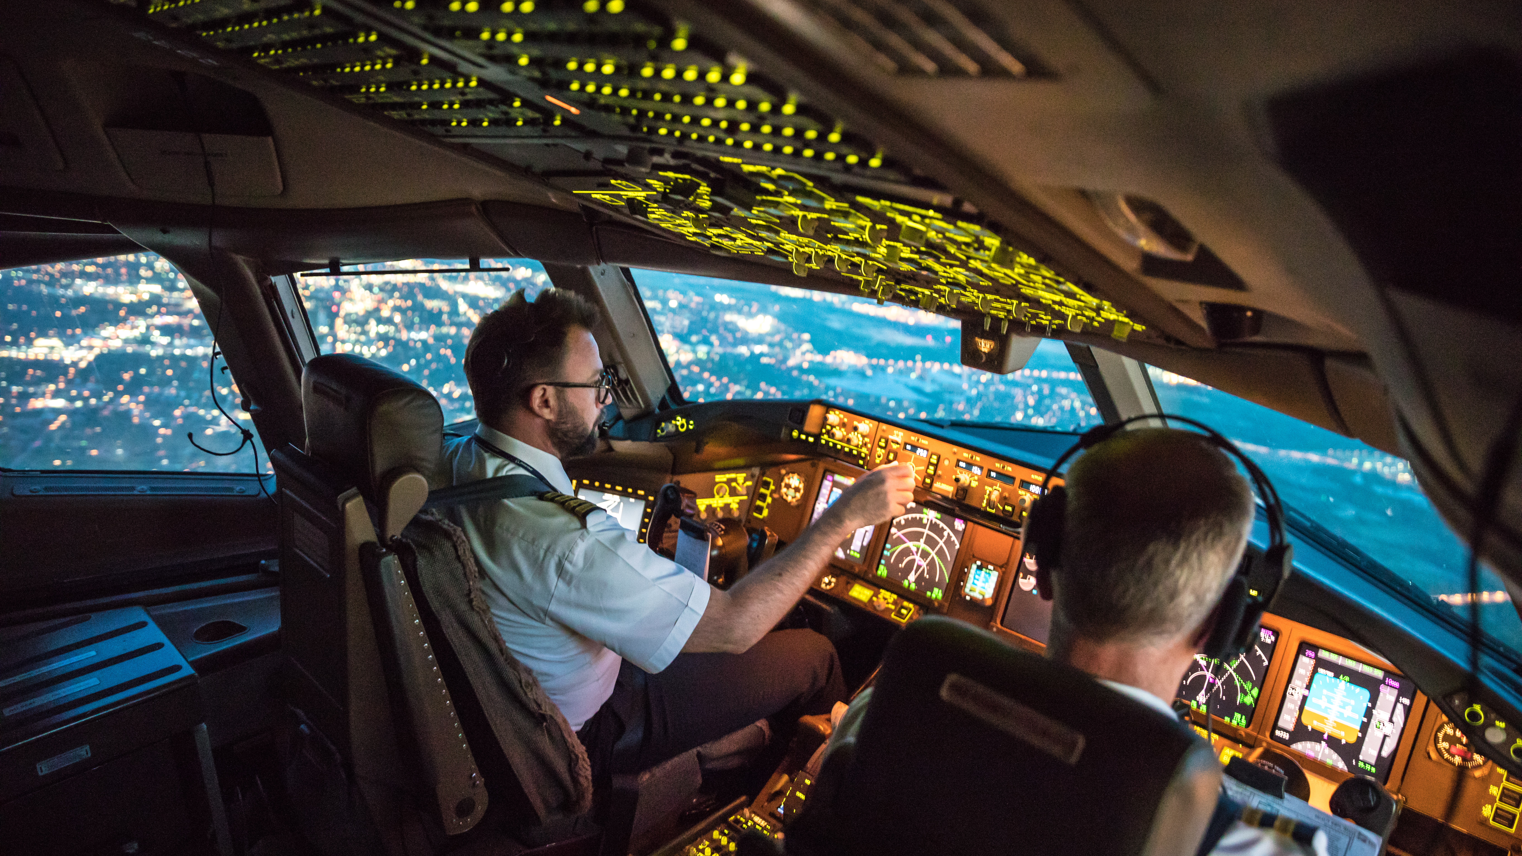
Thanks
Page 15

Slide 16
CPL Flight Test Statistics
Year | Total Candidates | Total Flight Tests | Pass 1st Attempt | Pass 2nd Attempt | Pass 3rd Attempt | Pass 4th Attempt | Pass 5th Attempt | Yet to Pass
2017 | 218 | 260 | 169 | 36 | 1 |  |  | 12
2018 | 304 | 377 | 233 | 53 | 8 |  |  | 10
2019 | 169 | 215 | 118 | 36 | 5 |  |  | 10
2020 | 300 | 408 | 190 | 60 | 14 | 2 | 1 | 32
2021 | 384 | 536 | 250 | 80 | 25 | 2 | 1 | 26
Page 16

Slide 17
IR Flight Test Statistics
Year | Total Candidates | Total Flight Tests | Pass 1st Attempt | Pass 2nd Attempt | Pass 3rd Attempt | Pass 4th Attempt | Yet to Pass
2017 | 194 | 215 | 172 | 19 |  |  | 3
2018 | 226 | 266 | 193 | 30 | 4 |  | 9
2019 | 110 | 127 | 89 | 11 | 3 |  | 7
2020 | 211 | 248 | 173 | 24 | 3 |  | 12
2021 | 244 | 305 | 1095 | 39 | 5 | 1 | 9
Page 17

Slide 18
C-Cat Flight Test Statistics
Year | Total Candidates | Total Flight Tests | Pass 1st Attempt | Pass 2nd Attempt | Pass 3rd Attempt | Yet to Pass
2017 | 104 | 112 | 94 | 8 |  | 2
2018 | 113 | 128 | 93 | 11 |  | 9
2019 | 54 | 56 | 46 | 2 |  | 6
2020 | 112 | 140 | 78 | 19 | 3 | 12
2021 | 89 | 95 | 78 | 6 |  | 5
Page 18

Slide 19
B-Cat Flight Test Statistics
Year | Total Candidates | Total Flight Tests | Pass 1st Attempt | Pass 2nd Attempt | Pass 3rd Attempt | Yet to Pass
2017 | 66 | 70 | 59 | 4 |  | 3
2018 | 64 | 68 | 59 | 2 |  | 3
2019 | 51 | 55 | 45 | 4 |  | 2
2020 | 50 | 51 | 44 | 1 |  | 5
2021 | 20 | 23 | 14 | 3 |  | 3
Page 19

